Slide 1
User Interface Design Patterns
Bricolage: example-based retargeting for web design
Study what designs are doing, and ask why
Emergency fire door in GHC
Web sites too
Programming Usable Interfaces (PUI)
05-430/05-630 Fall 2018
Jason Hong
jasonh@cs.cmu.edu
Notes:
https://www.youtube.com/watch?v=CGnfKnfY6EM

Slide 2
Recap
Today is final part of the design and rapid prototyping phase of PUI
What is design?
Early stages of design / Paper prototyping
Evaluation (see UCRE class for more methods)
Design specs
Today is about design patterns
Next week, we’ll look at web implementation and underlying structures of all GUIs

Slide 3
Core Idea of Design Patterns
Don’t reinvent the wheel
Instead, use well-known good design solutions
We’ll talk more about the pros and cons of design patterns in a sec, but first, an example
Will show several different web pages
Ebay, NYTimes, Amazon, CMU
Focus on the Navigation Bar

Slide 4
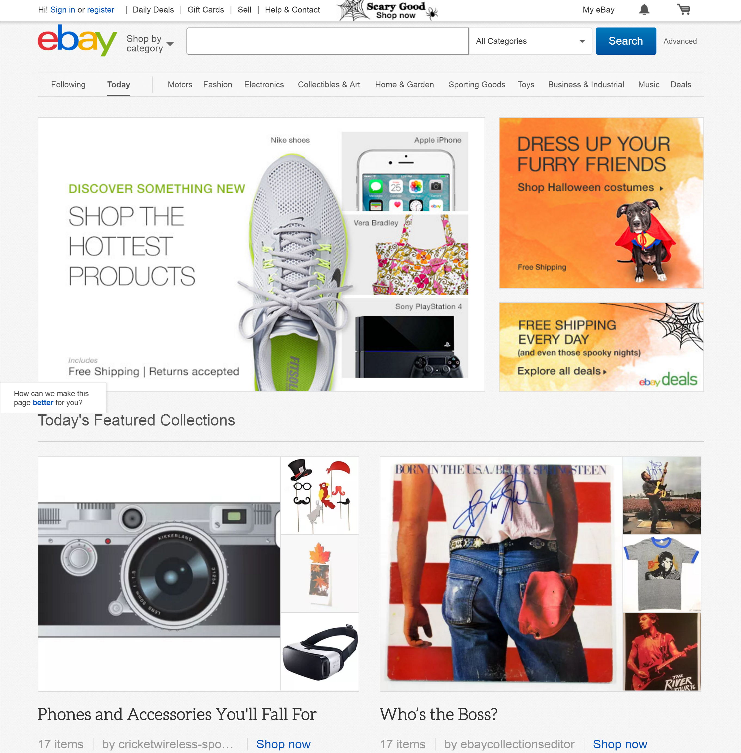
Notes:
Ebay page

Slide 5
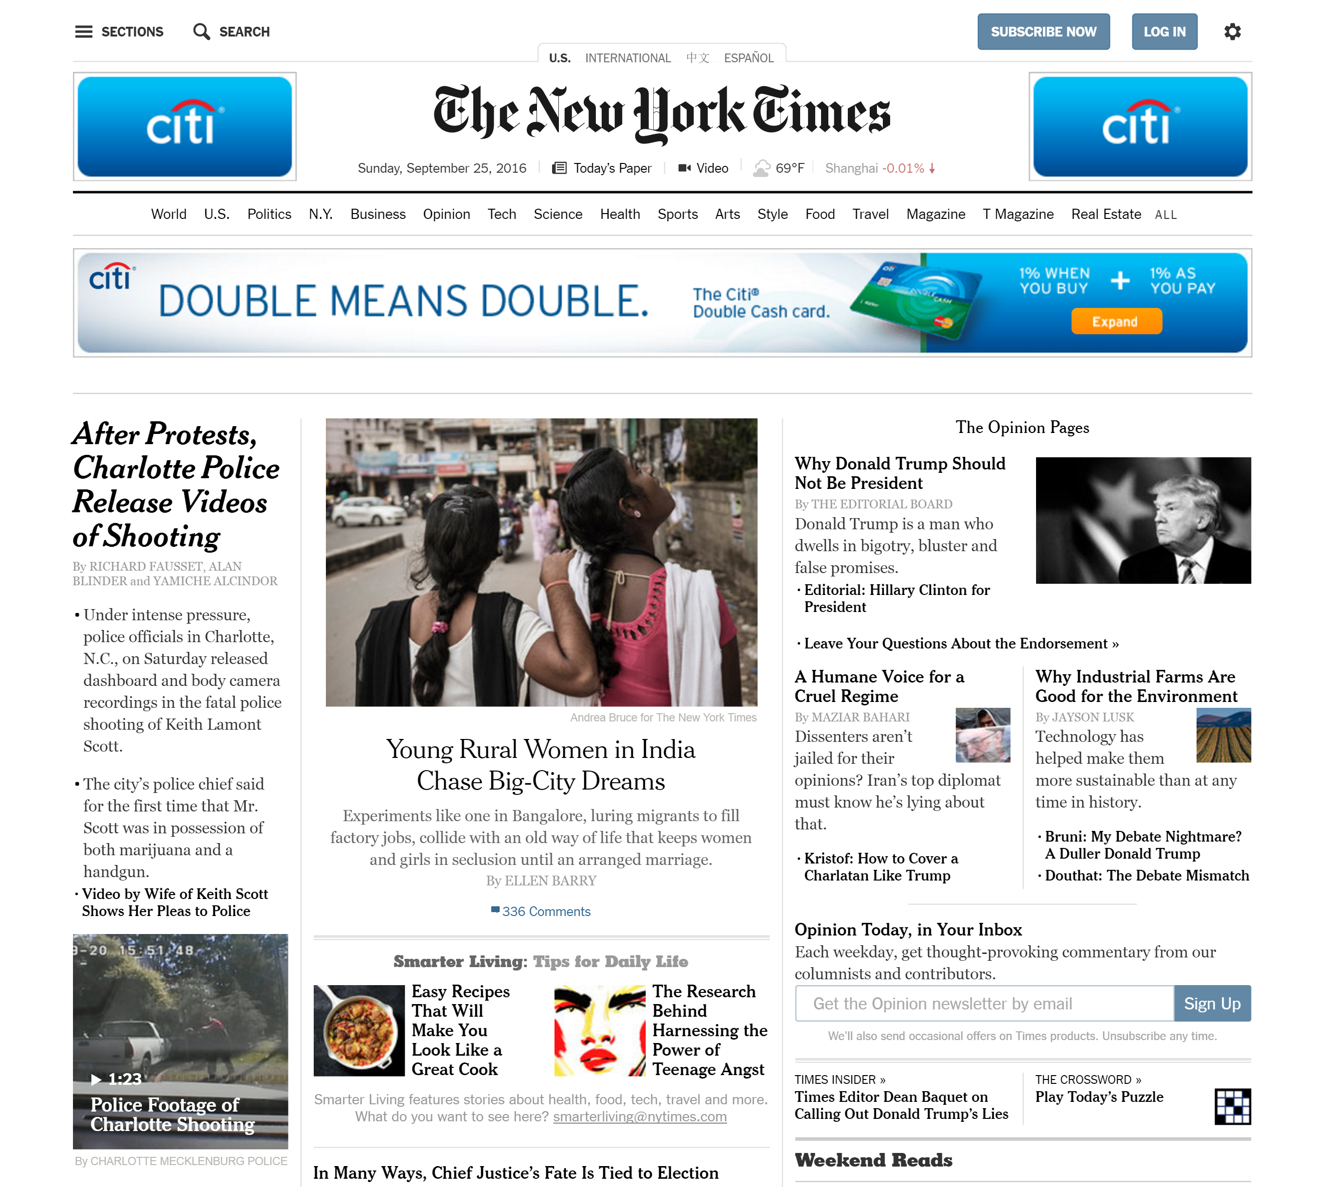
Notes:
NYTimes

Slide 6
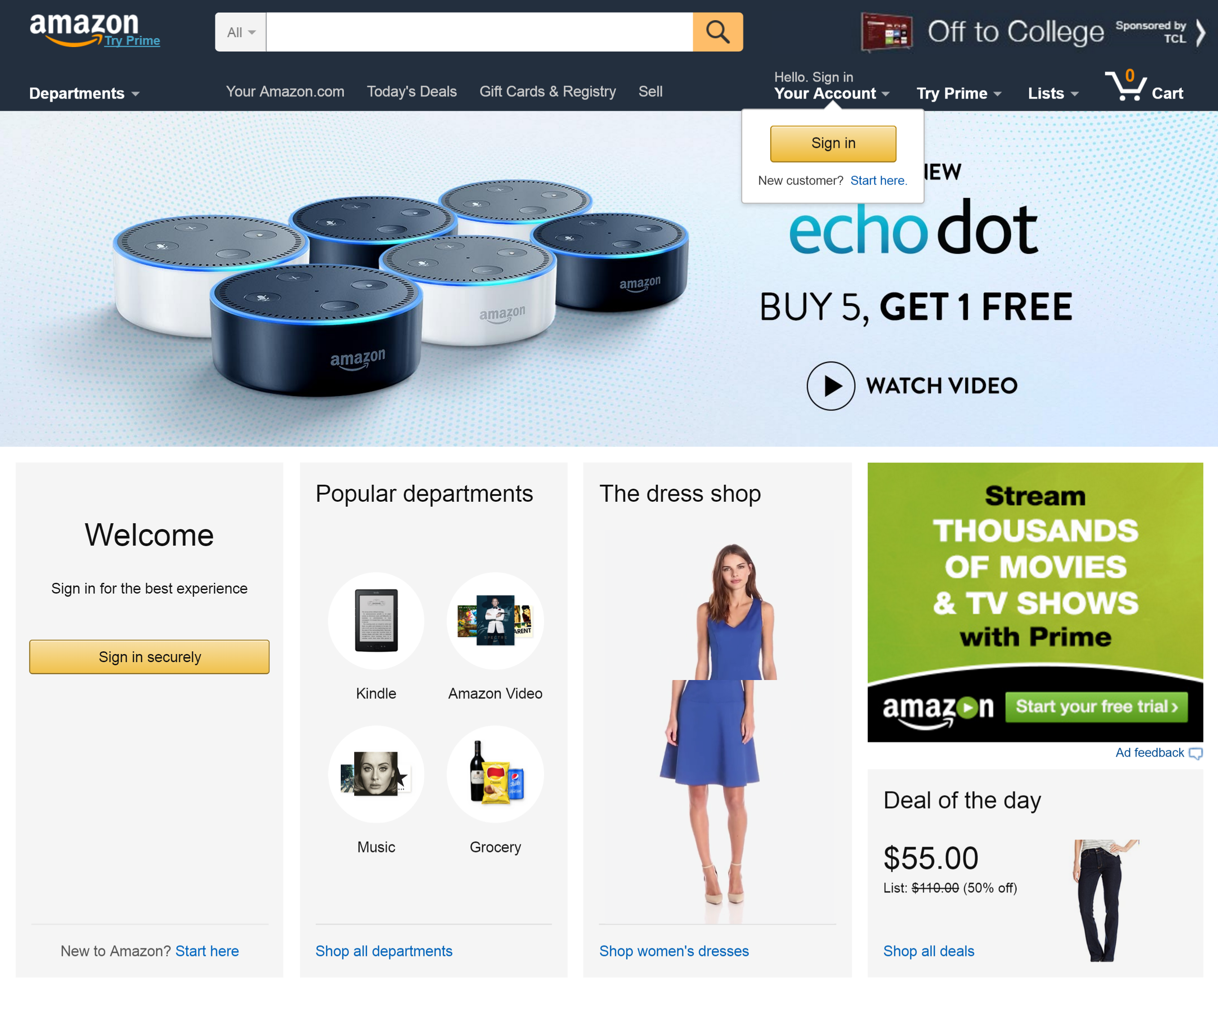
Notes:
Amazon. Note that the woman got splinched, that’s an artifact of screen capture

Slide 7
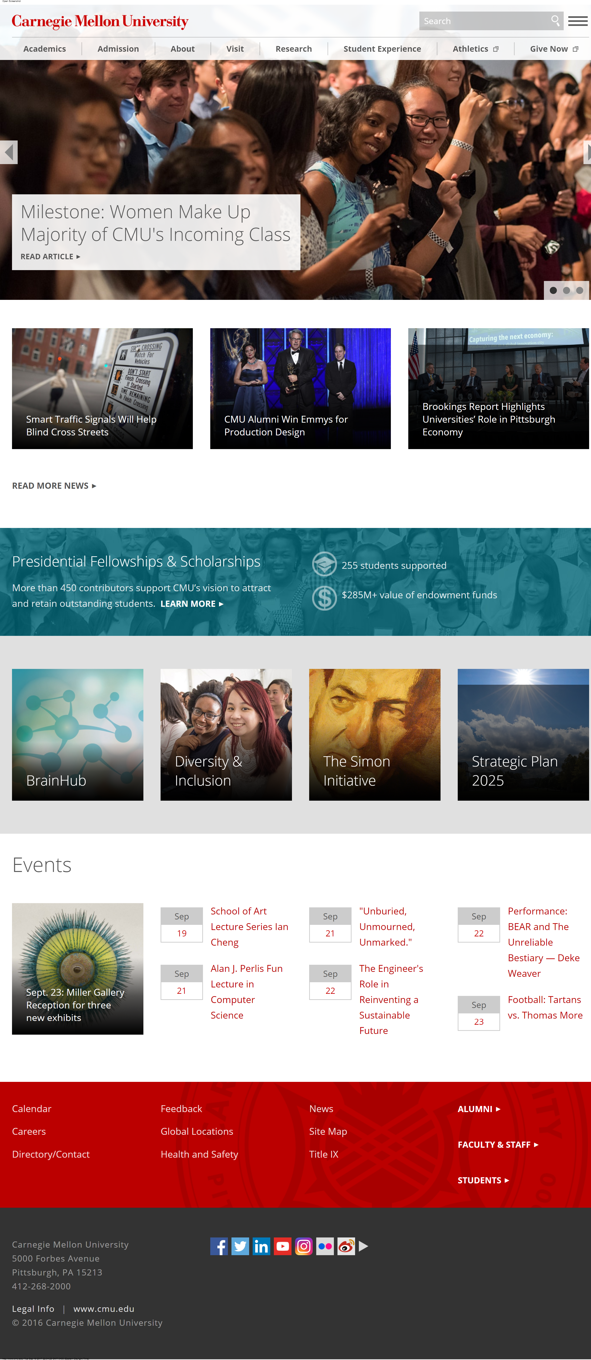
Notes:
CMU home page

Slide 8
Four Different Navigation Bars Same in Essence But Different in Specifics

Slide 9
Four Different Navigation Bars Same in Essence But Different in Specifics
Position (top of page)
Shows major subsites
Logo at top-left (clickable)
Notes:
Same basic position on web pages
Shows major subsites
Same in essence, but different in implementation

Slide 10
Why Design Patterns?
Design is about finding solutions
Unfortunately, designers often reinvent
Design patterns communicate common design problems and good solutions
Explains what the problem is
Gives a name to the solution (ex. Navigation Bar)
Why the solution is done the way it is
How to reuse the solution
Connects to other patterns

Slide 11
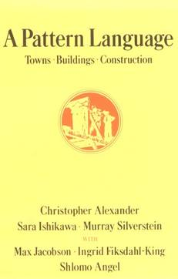
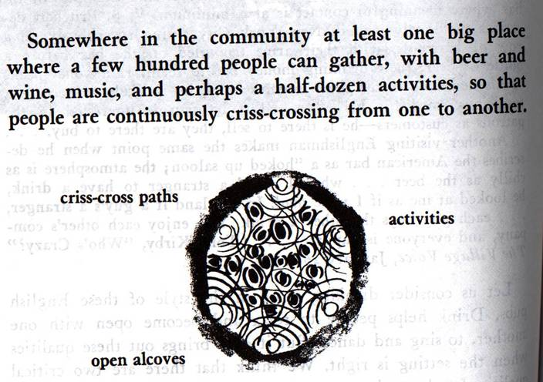
Design Patterns in Architecture
First used in architecture [Alexander]
Ex. How to create a beer hall where people socialize?
Beer Hall (90)

Slide 12
Design Patterns
Design patterns communicate common design problems and solutions
First used in architecture [Alexander]
Ex. How to create a beer hall where people socialize?
Notes:
12

Slide 13
Using Design Patterns
Want patterns to be not too general and not too specific
Goal is to use a solution “a million times over, without ever doing it the same way twice”
That is, don’t directly copy, but do take inspiration
Notes:
Quote is from the original design patterns book

Slide 14
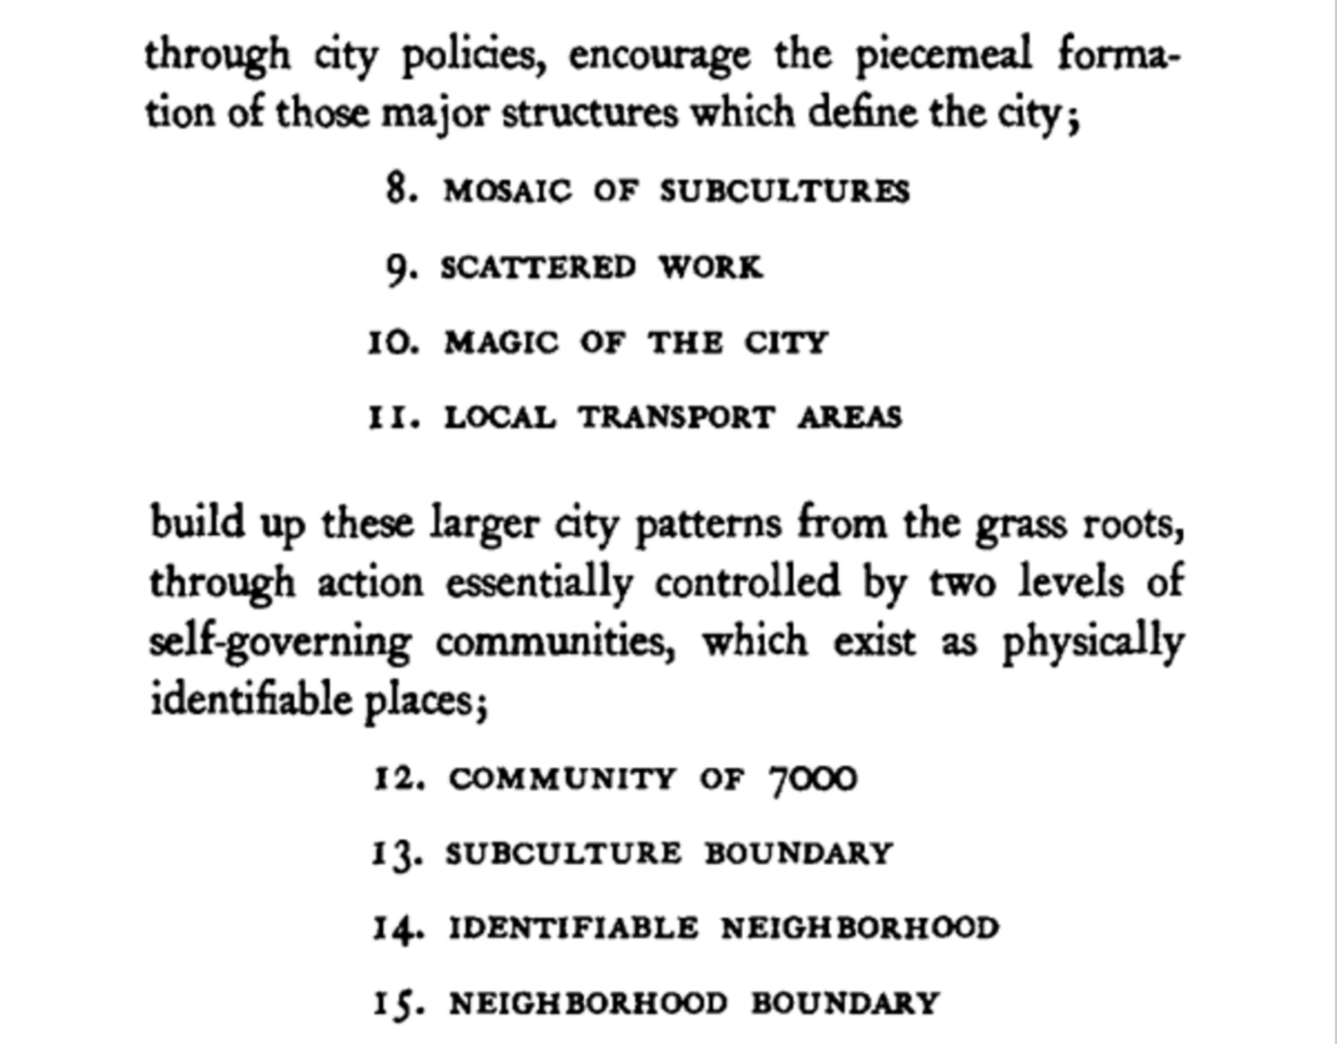
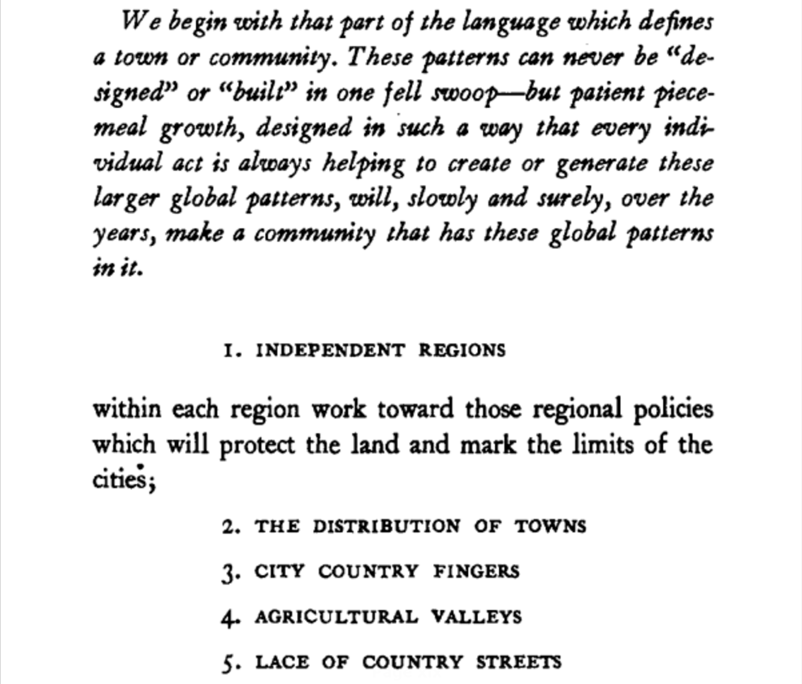
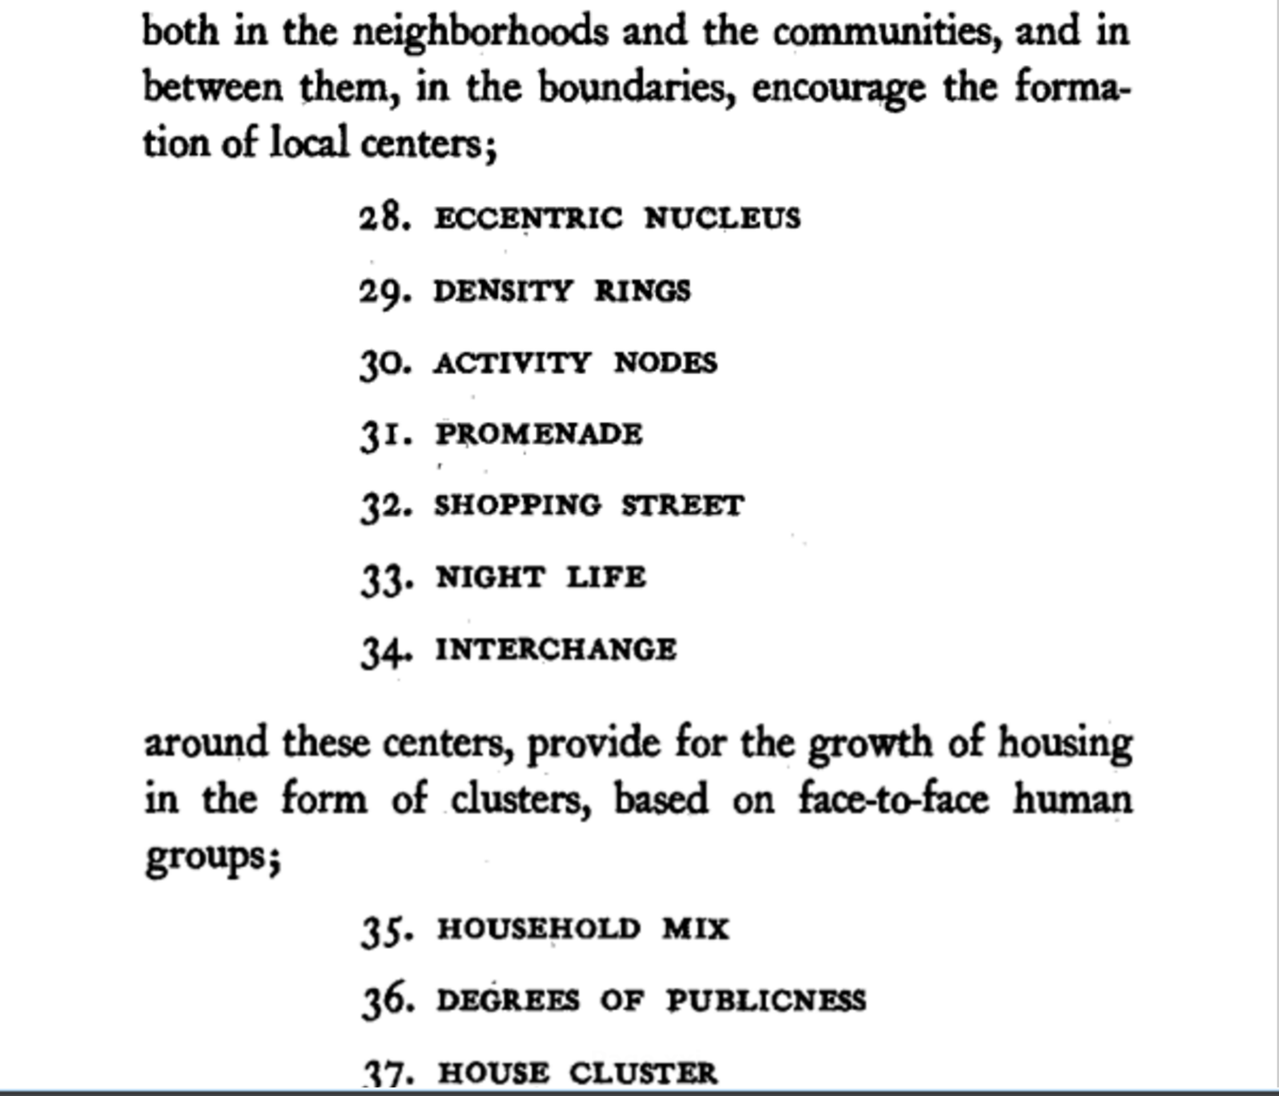
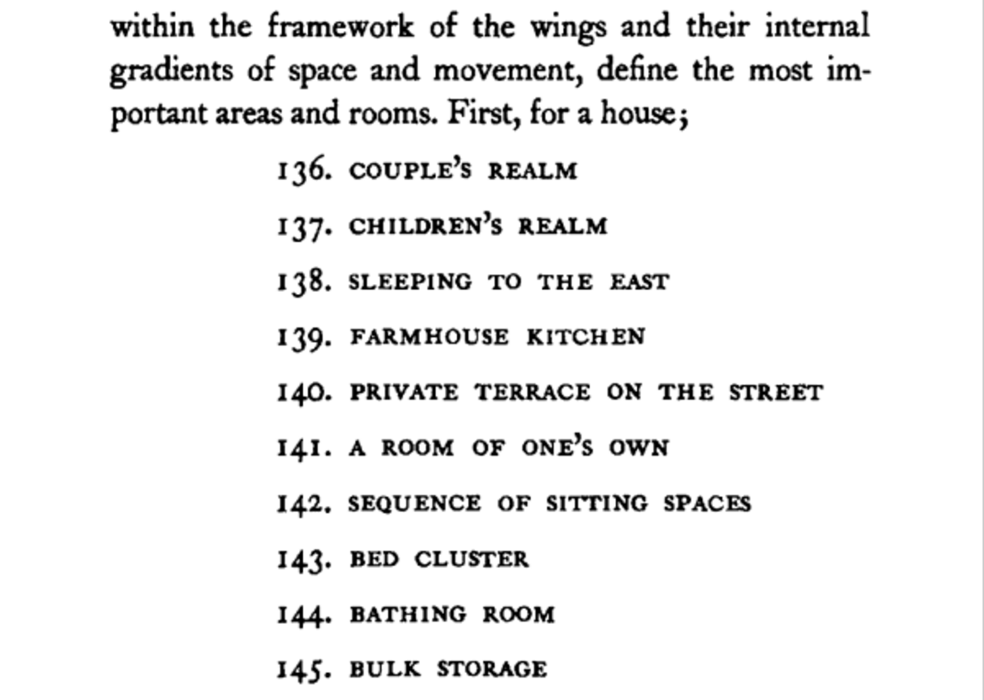
Hierarchical Patterns
Patterns can exist and be applied at all levels
Ex. Regions, Cities, Neighborhoods, Houses
Notes:
Alexander also organized patterns in hierarchy, with patterns about entire regions, cities, neighborhoods, buildings, and rooms. Graphlike structure.

Slide 18
A Web of Design Patterns
(8) Mosaic of Subcultures
Cities
& Towns
(31) Promenade
(33) Night Life
(90) Beer Hall
Local
Gatherings
(95) Building Complex
Interiors
(179) Alcoves
(181) The Fire
Notes:
18

Slide 19
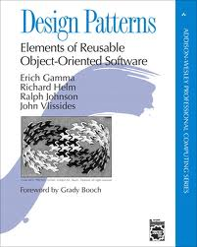
Why Else Are Patterns Useful?
Popular among software devs
Ways of structuring systems
Note: one weakness is lack of hierarchy in their patterns
People more familiar with other sites / apps than yours
Makes sense to use common conventions
Total time spent on other sites is greater than on your site
Notes:
Connect design patterns with software engineering, so designers in the room know it’s a similar concept
For the software developers familiar with this popular book, should be aware that one of the big things that this book missed is the hierarchy of patterns

Slide 20
Why Else Are Patterns Useful?
More likely to be a tested design
Taking patterns from large companies
Likely spent a lot of design time and money
Can raise level of abstraction for communication
Gives common vocabulary for design team
Ex. In HTML, no <navbar> tag
Ex. In HTML, no <shoppingcart> tag

Slide 21
Exercise: Identify More Patterns
Find a partner in class
Use screenshots in first part of class
Ebay, NY Times, Amazon, CMU
If you have laptop, can also load those pages up
Stick with home pages for now
Identify other potential design patterns
Design problems, Design solutions, Name
Spend ~8 minutes
Will get back together and aggregate results

Slide 22
Your Examples of Patterns
Footer – don’t want to overstuff the nav bar (contacts, site map)
Search bar – quick keyword search / ecommerce centralized feature / categorized search / standard icon magnifying glass
My account / personalization
Shopping carts (near top right)
Carousels
Account info / profile
Pagination / keep things from getting too long
Banner ads
Card designs / content modules
Notes:
From last year
Rotating Banners
Showcase content, change, liveness
Fixed vs dynamic content
Content well
Nice square boxish content
Sidebars
GUI focus in the right place
Search by category
Grid layout
Smaller columns for NYTimes
Amazon has bigger columns
Banner ads / top-right or headers
Big photo on front page
Search bar and nav bar / position often middle
Footer / miscellaneous
Logos at top-left and clickable to go home
Good contrast

Slide 23
Featured content
Hamburger menu
Regions / change language
Rectangular / grid
Non intrusive non-annoying background
Logo to go home
Full width for main navigation / subdivided into content areas in columns

Slide 24
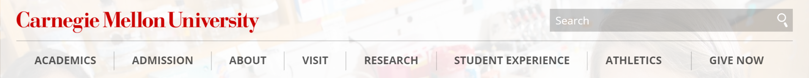
Some of My Examples
Search Bar
Often at top left or top-right

Slide 25
Some of My Examples
Clickable Logos for Home Page
Often at top left

Slide 26
Some of My Examples
Account Settings
Often at top-right

Slide 27
Some of My Examples
Content Modules
Can add content from CMS
Clear visual “boxes”
Notes:
Ebay page

Slide 28
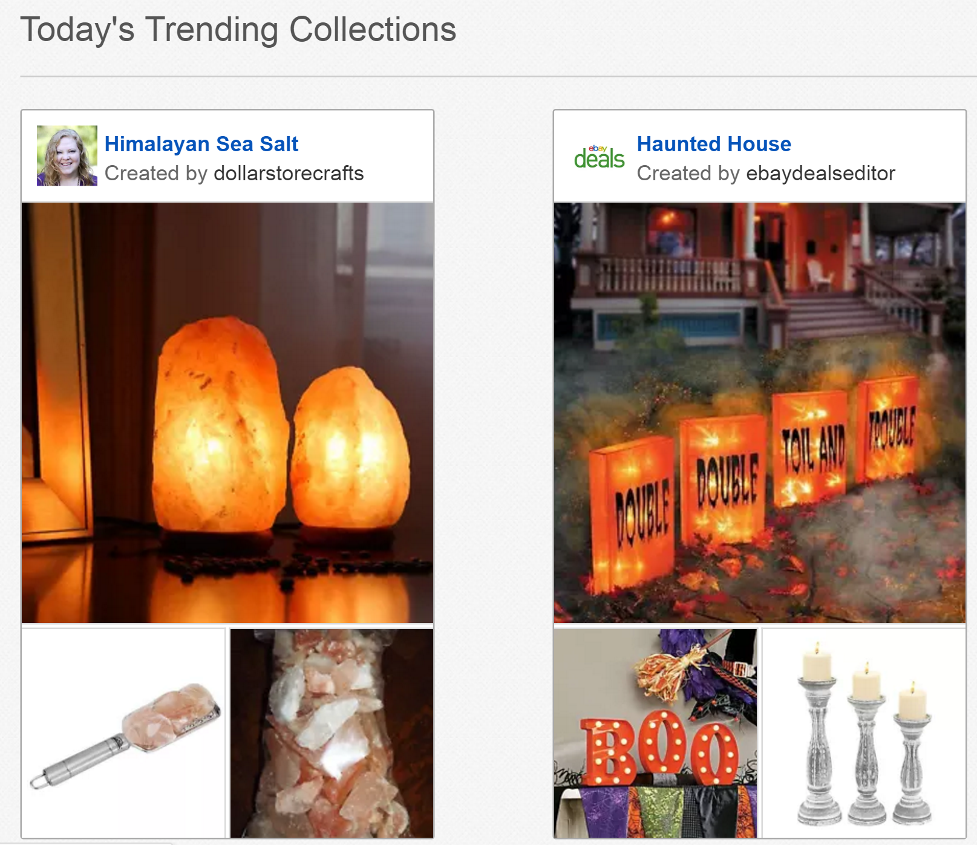
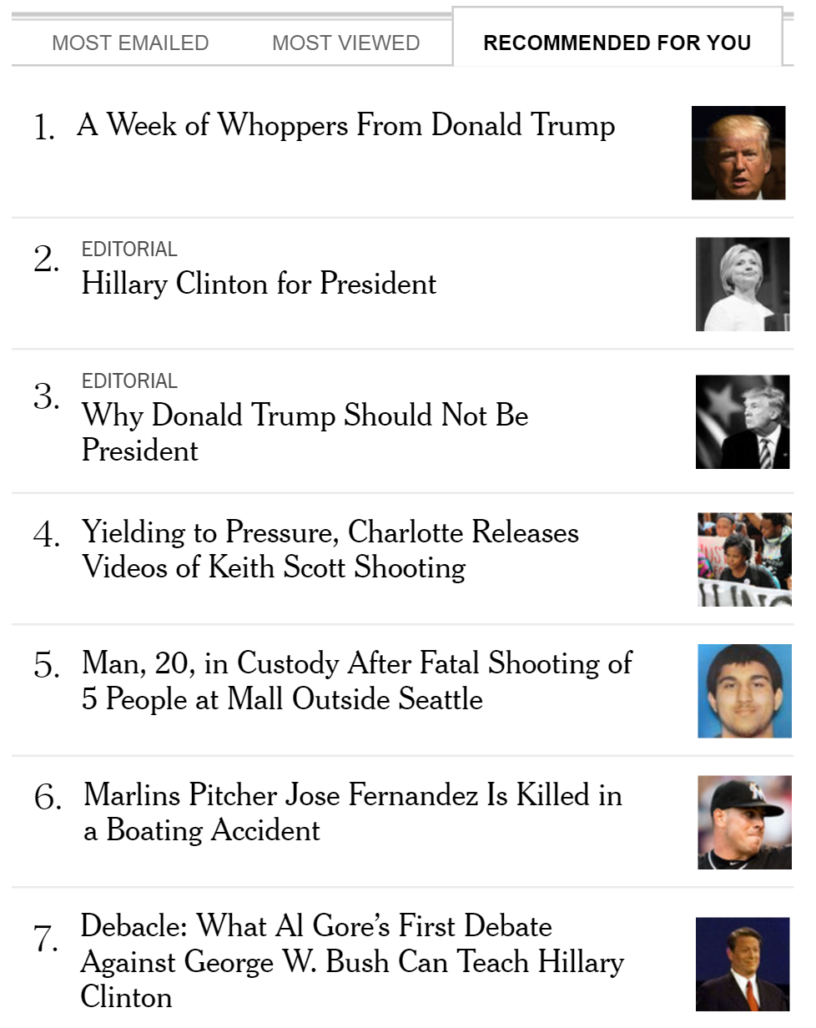
Some of My Examples
Multiple Forms of Navigation
In these examples, trending / popular

Slide 29
Some of My Examples
Above the Fold
Most important content visible w/o scrolling

Slide 30
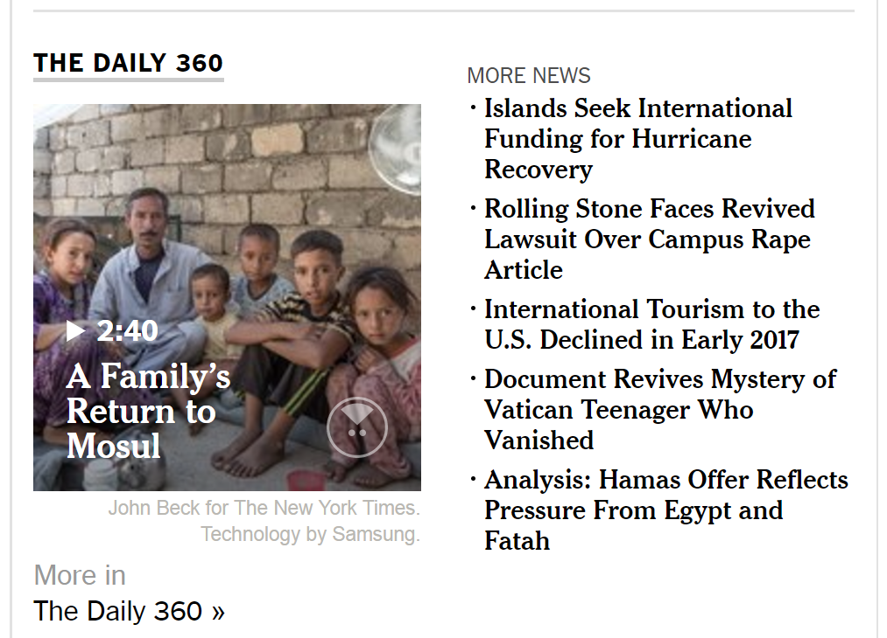
Some of My Examples
Obvious Links
Used to be blue and underlined
These days, more important is correctly guessable
Notes:
Ebay page

Slide 31
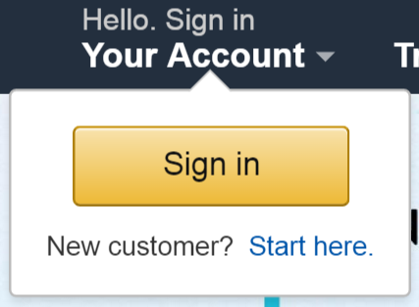
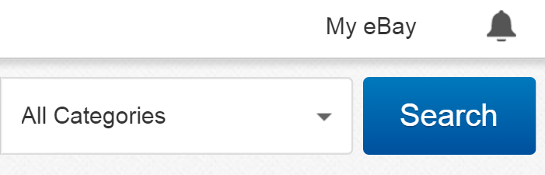


Some of My Examples
High Visibility Action Buttons

Slide 32
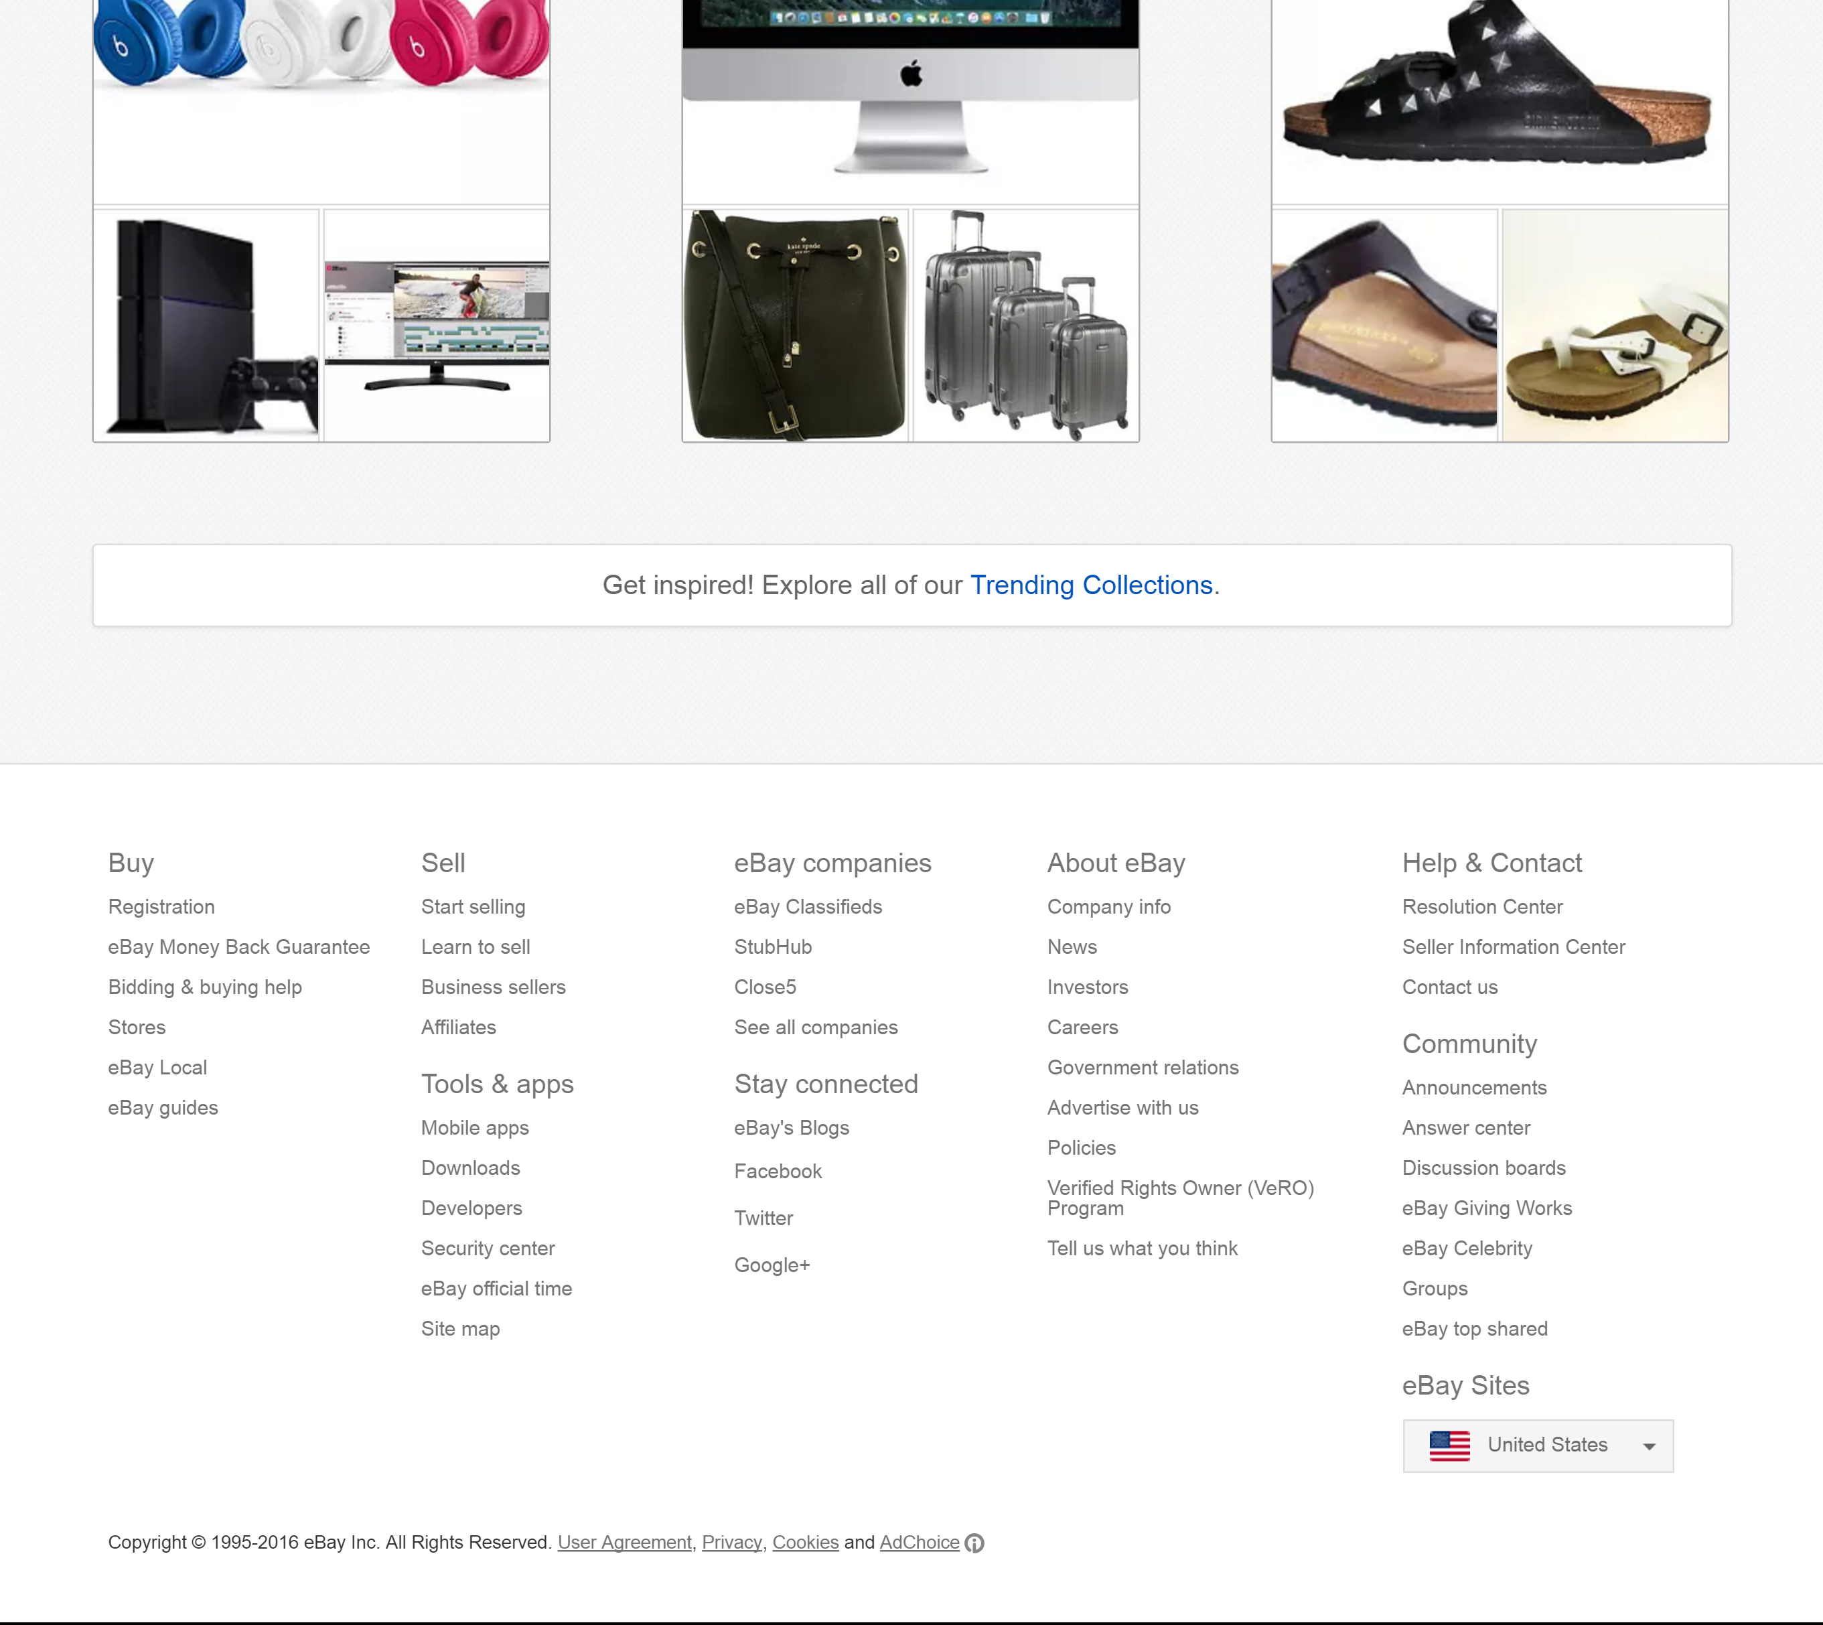
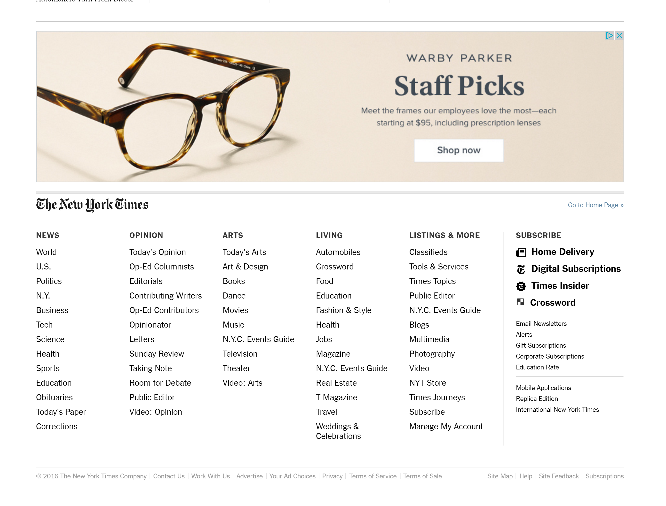
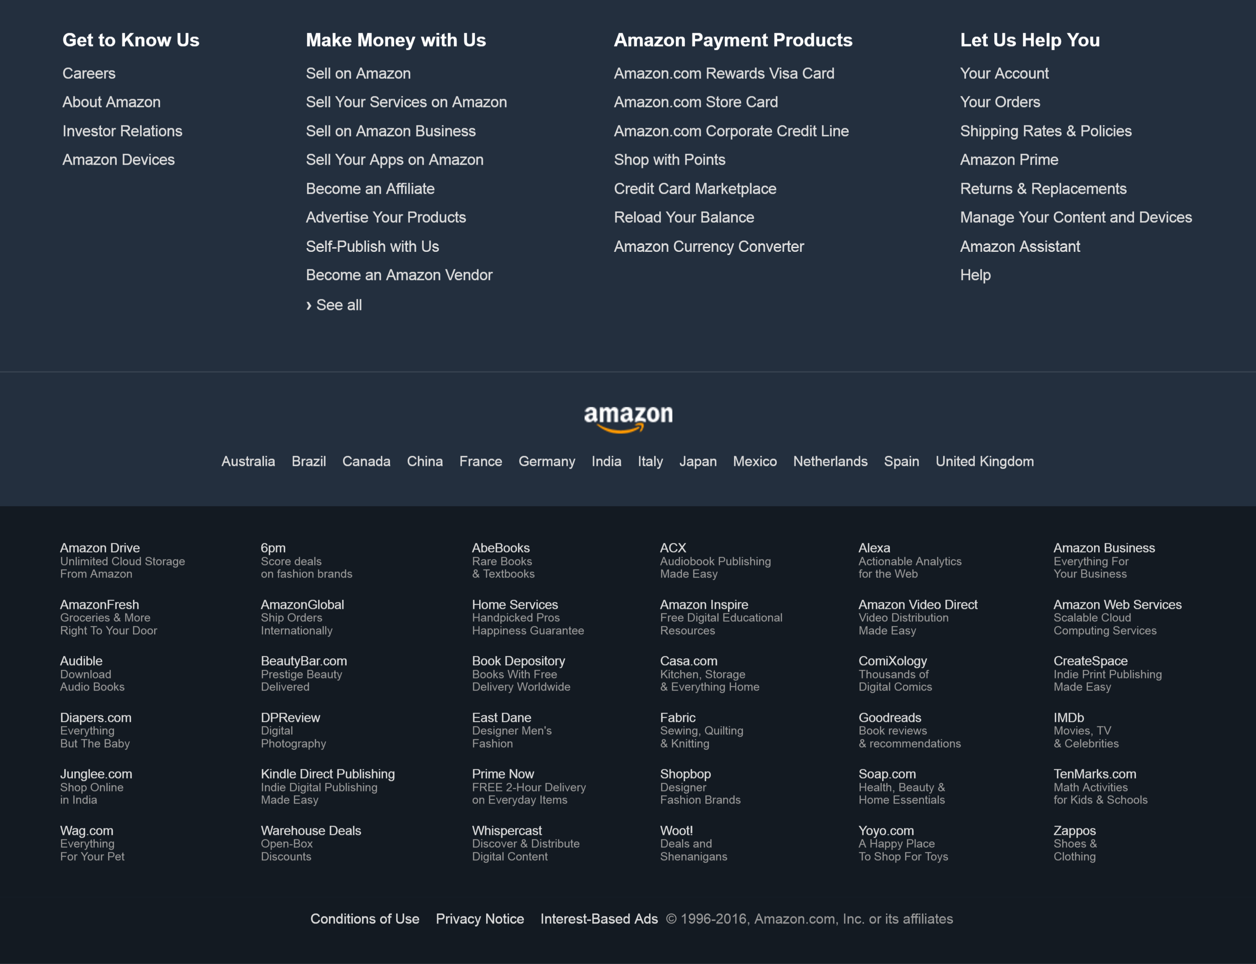
Some of My Examples
Auxiliary Information
Privacy Policy, Terms and Conditions, Legal info
Mini Site Map
Tends to be at bottom of page

Slide 33
Notes:
Ebay page

Slide 36
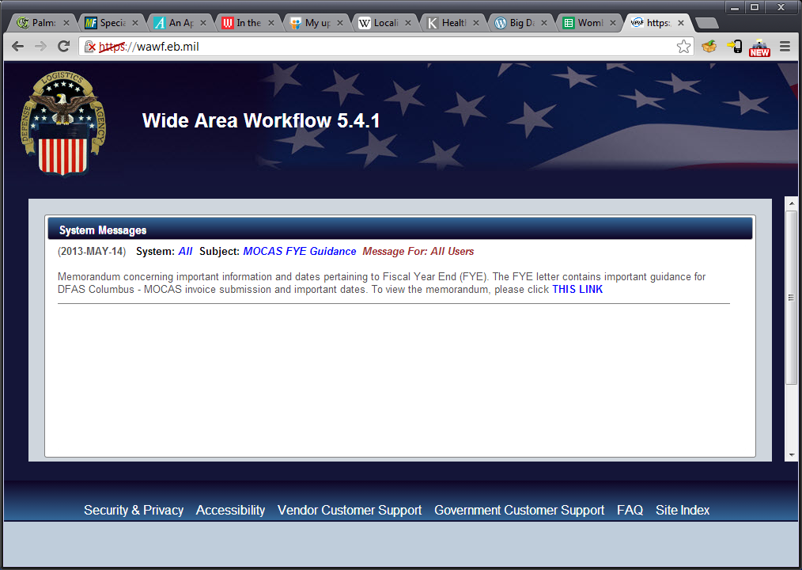
Previous Example Above the Fold
Notes:
This is the Wide Area Workflow site. This is the site where you can submit invoices to the US government if you have a contract. Now, imagine you just came to this site for the first time. Tell me about what you see.

Slide 37
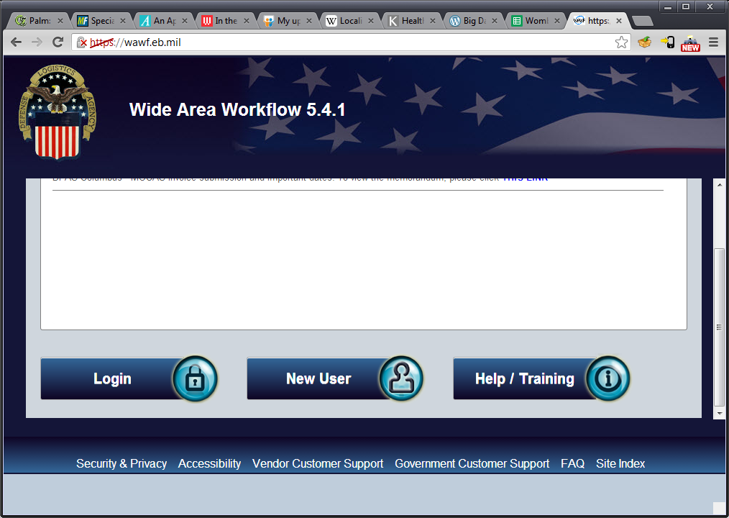
Previous Example Above the Fold
Notes:
So the problem on the previous screen is that there’s no clear action at all of what to do. It turns out that you have to scroll down to see the important parts, ie login, new user, etc.
There’s also this weird grey area on the bottom which wasn’t used, not sure why.

Slide 38
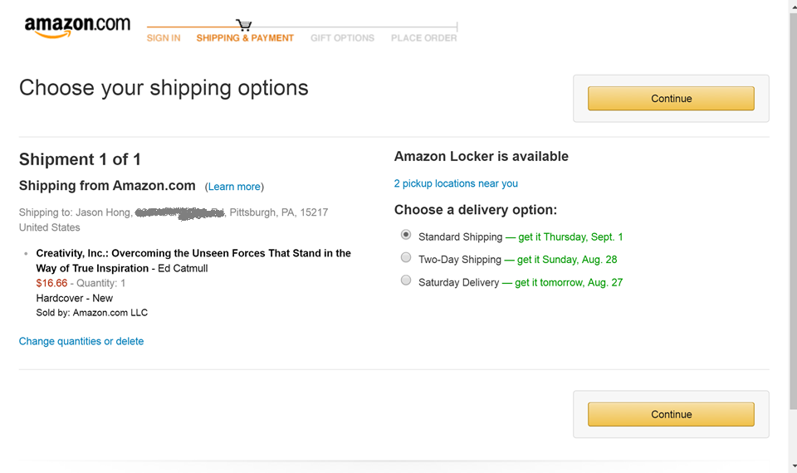
Previous Example High Visibility Action Buttons
Notes:
Note how Amazon has the same button twice, at top and at bottom. So if you scroll, you’ll still see the button to continue.

Slide 39
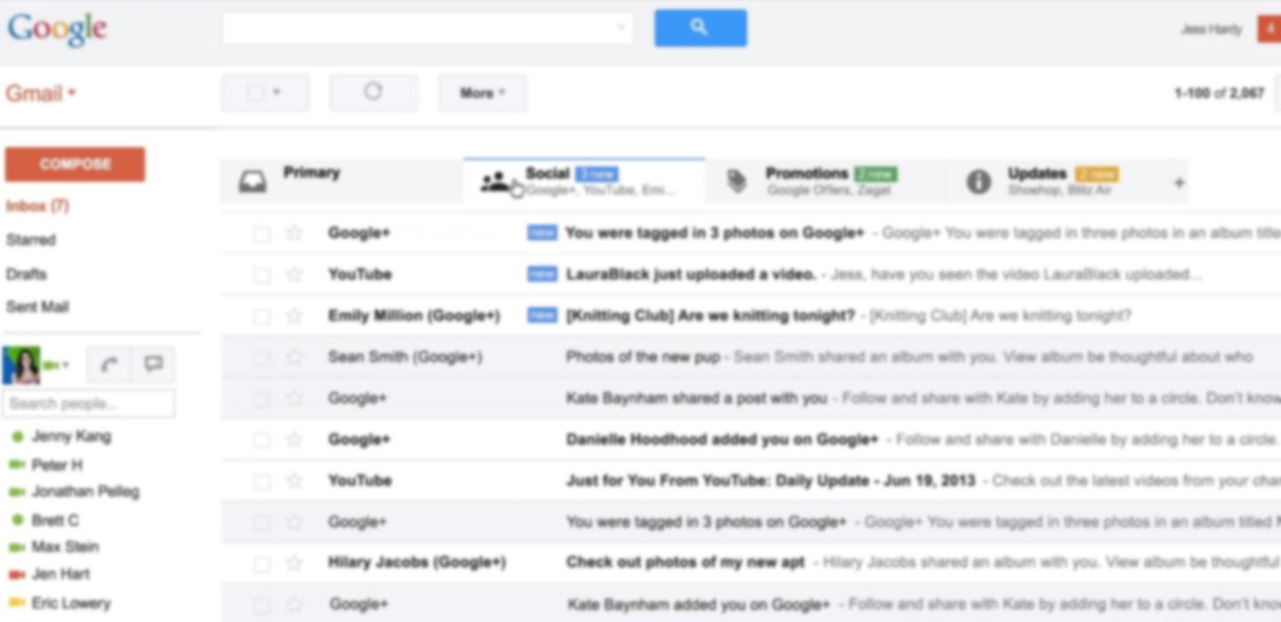
Another Example High Visibility Action Buttons
Notes:
This is a deliberately blurred version of Gmail. Note that the red “Compose” button on the left is really visible, as is the blue search button. Good consistent visual design for Google web properties makes them easy to use, and you can transfer your knowledge well too across Google web sites.

Slide 40
Patterns vs Guidelines
Patterns tend to be nouns
Navigation Bar, Shopping Cart, Obvious Links
Though always some exceptions (Above the Fold)
Patterns are generative
Guidelines offer high level suggestions, but don’t help you create concrete designs for problems
Ex. Visibility of system status, Recognition over recall are useful, but don’t tell you how to create a design
Patterns tend to be more specific (vs guidelines)

Slide 41
Summary so Far
Design patterns are good solutions to common design problems
Design patterns can also
Give common vocabulary (abstraction)
Help with finding usability problems
Offer inspiration for design ideas too

Slide 42
Administrivia
HW3 due later today Wednesday Sep 19
HW4 (HEval) due Fri Sep 21
HW5 out later today, due Mon Oct 1
No readings for next week’s class
Topic will be web basics
Be sure to do some online tutorials of HTML / CSS if you haven’t already

Slide 43
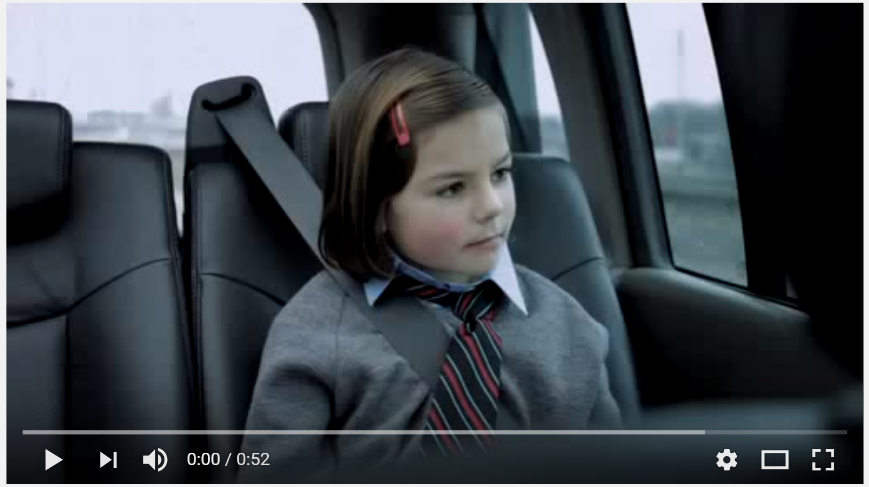
Storytelling
https://www.youtube.com/watch?v=CGnfKnfY6EM

Slide 44
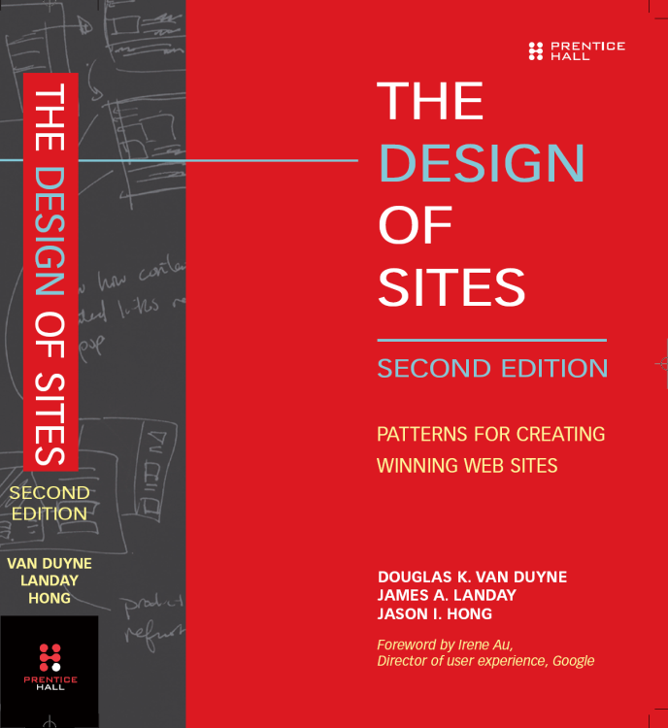
Many More Examples of Patterns
User Interface Design Patterns Library ui-patterns.com
Android Patterns www.androidpatterns.com
pttrns.com
My book

Slide 45




Pattern Groups
Our patterns organized by group
Site genres
Navigational framework
Home page
Content management
Trust and credibility
Basic ecommerce
Advanced ecommerce
Completing tasks
Page layouts
Search
Page-level navigation
Speed
The mobile web
Notes:
45

Slide 46
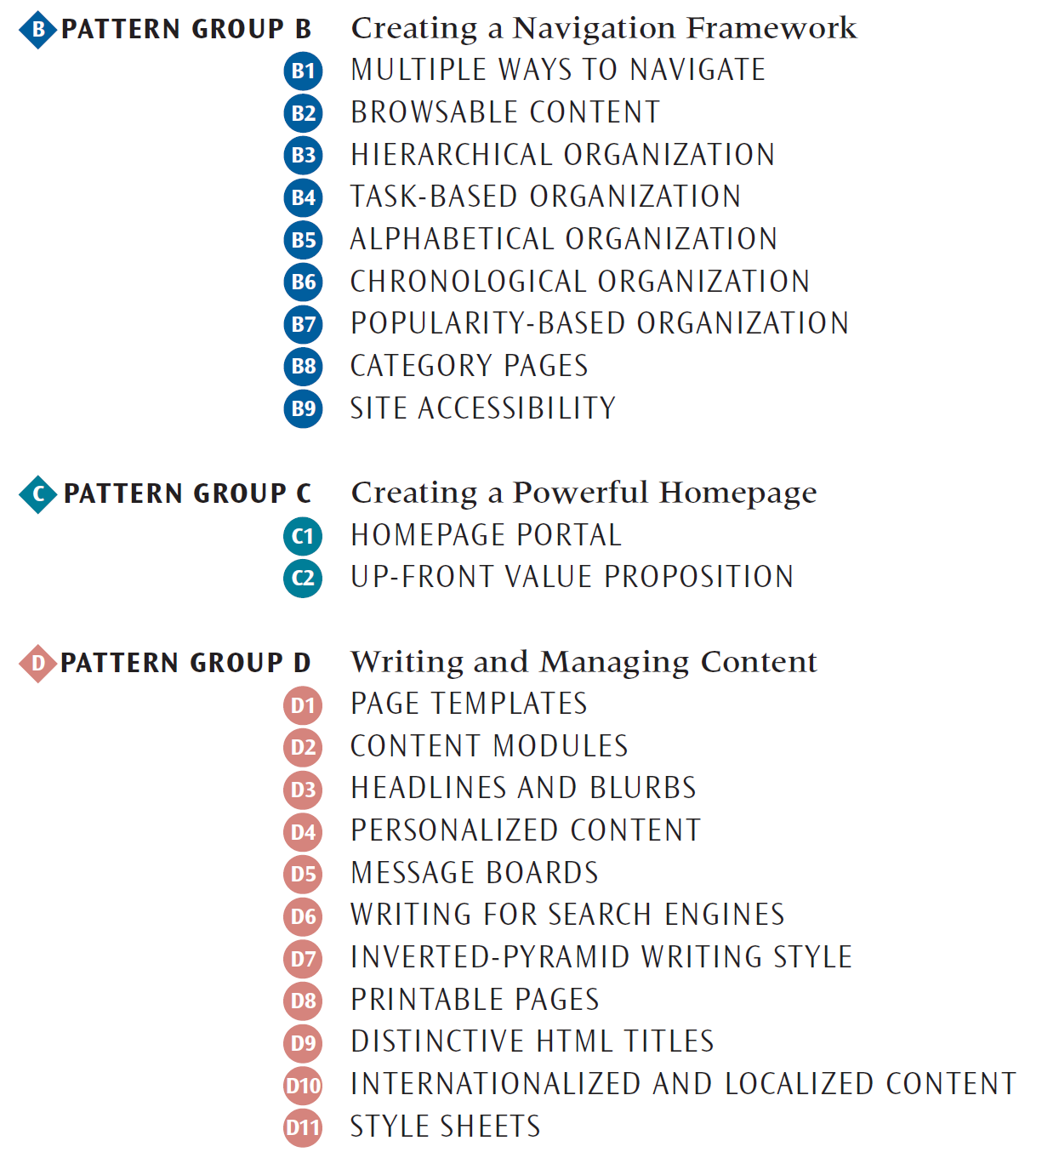
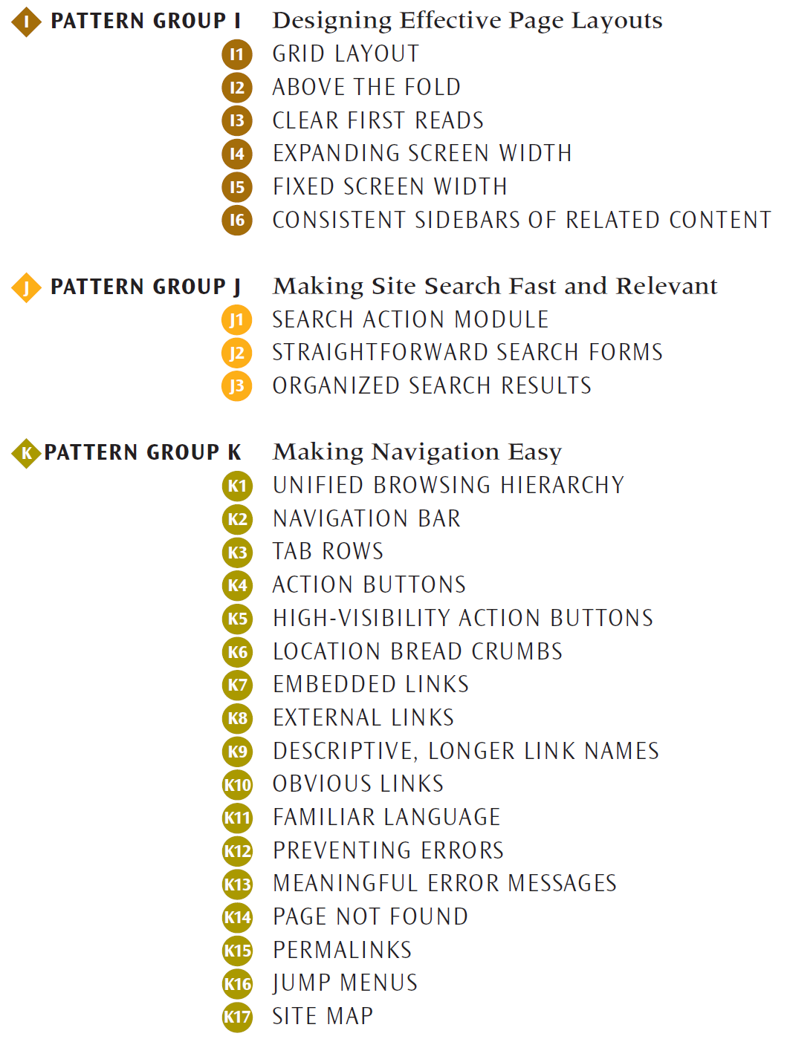
Example Patterns
Notes:
This is just to give you some vocabulary for talking about web design. Don’t expect you to buy the book.

Slide 47
Format of Web Design Patterns
Pattern Name and Number
Exemplar
Background
Problem
Forces
Solution
Solution Diagram
Related Patterns

Slide 48
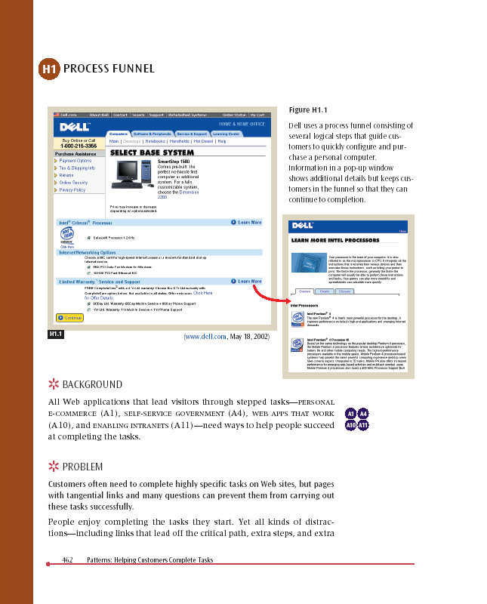
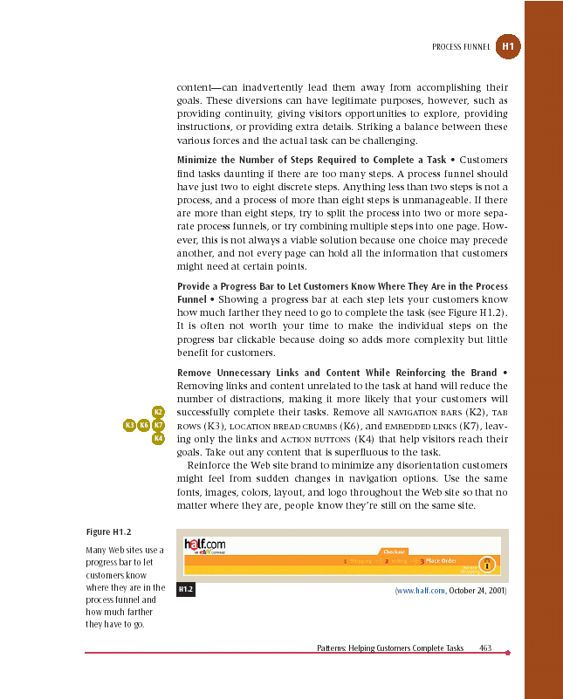
Pattern Name and Number
Exemplar
Forces &
Solution
Background
Problem Statement
Notes:
48

Slide 49
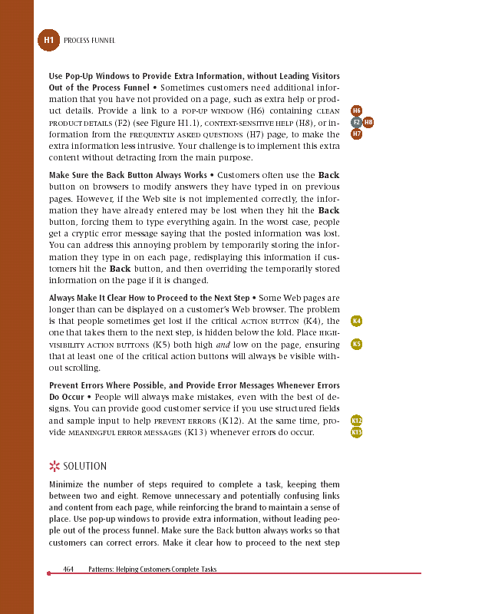
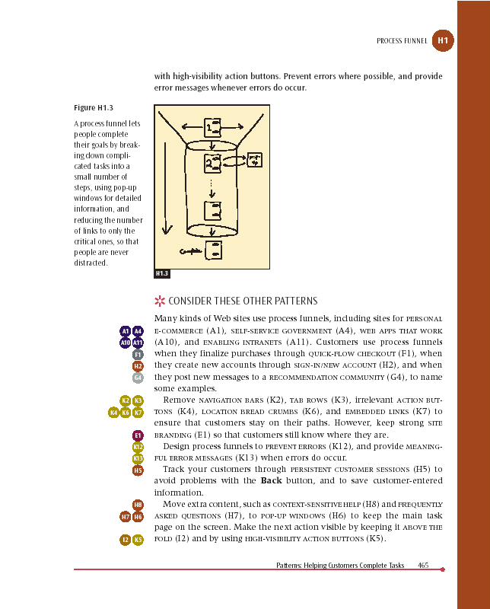
Bus Stops
Solution
Diagram
Related
Patterns
Solution
Summary
Notes:
49

Slide 50
Process Funnel (H1)
Problem
Customers often need to complete highly specific tasks on Web sites, but pages with tangential links and many questions can prevent them from carrying out these tasks successfully.
Notes:
This example is particularly useful, since it shows (a) a pattern in detail and (b) a really useful one that also (c) links to many other patterns

Slide 51
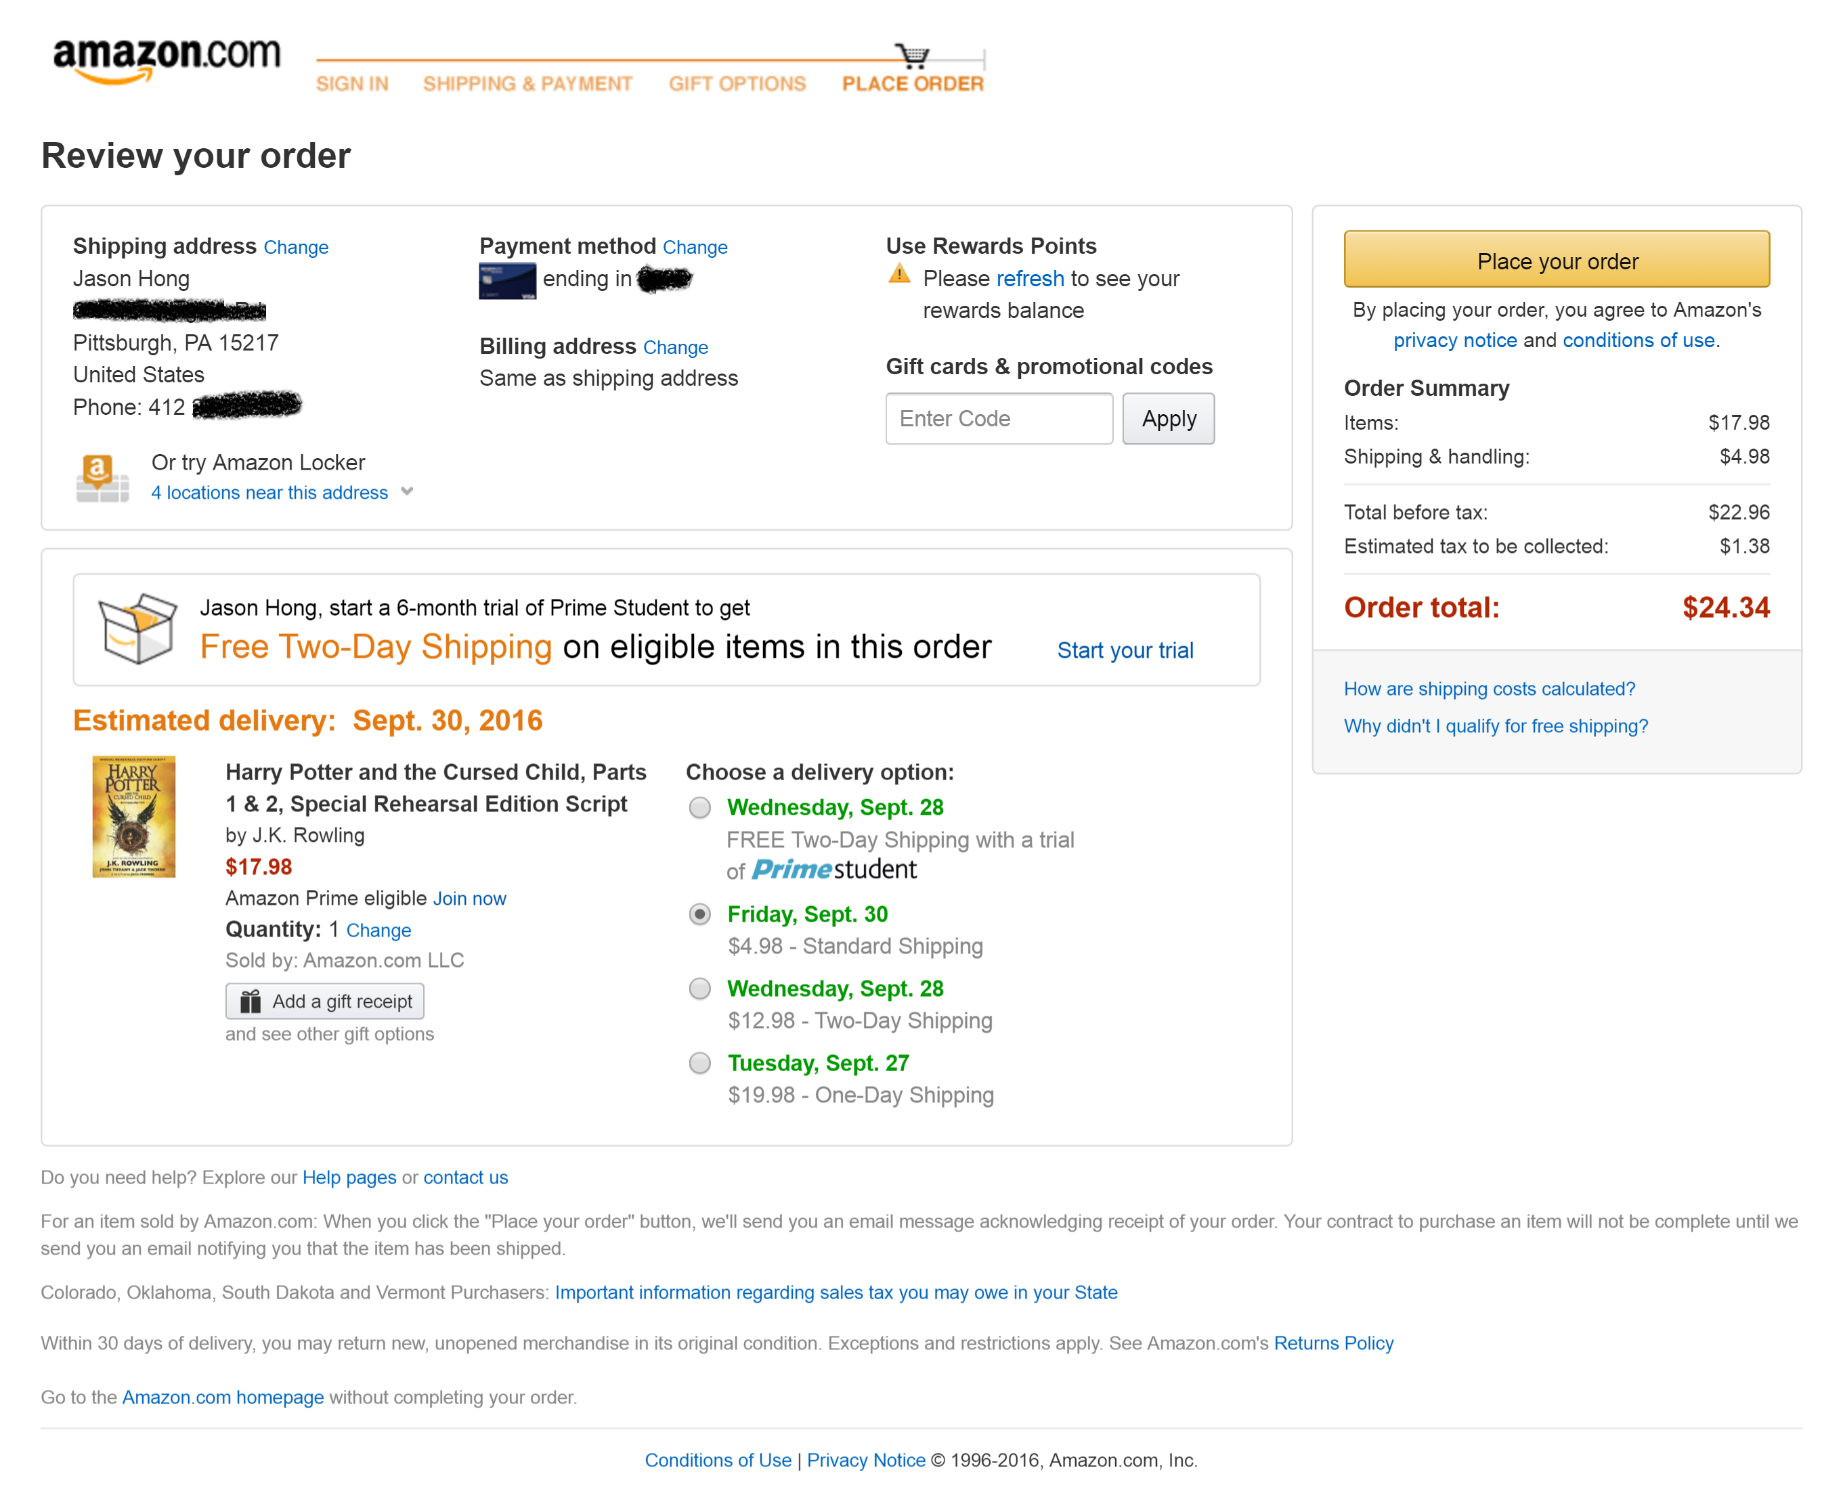
Example: Process Funnel (H1)

Slide 52
Example: Process Funnel (H1)
Note Nav Bar has been removed, Progress Bar instead. Why?

Slide 53
Example: Process Funnel (H1)
Keeps logo to help customers know what site they are on

Slide 54
Example: Process Funnel (H1)
Main action they want you to do is visually prominent

Slide 55
Example: Process Funnel (H1)
These links open up a new tab

Slide 56
Example: Process Funnel (H1)
This link opens up subwindow

Slide 57
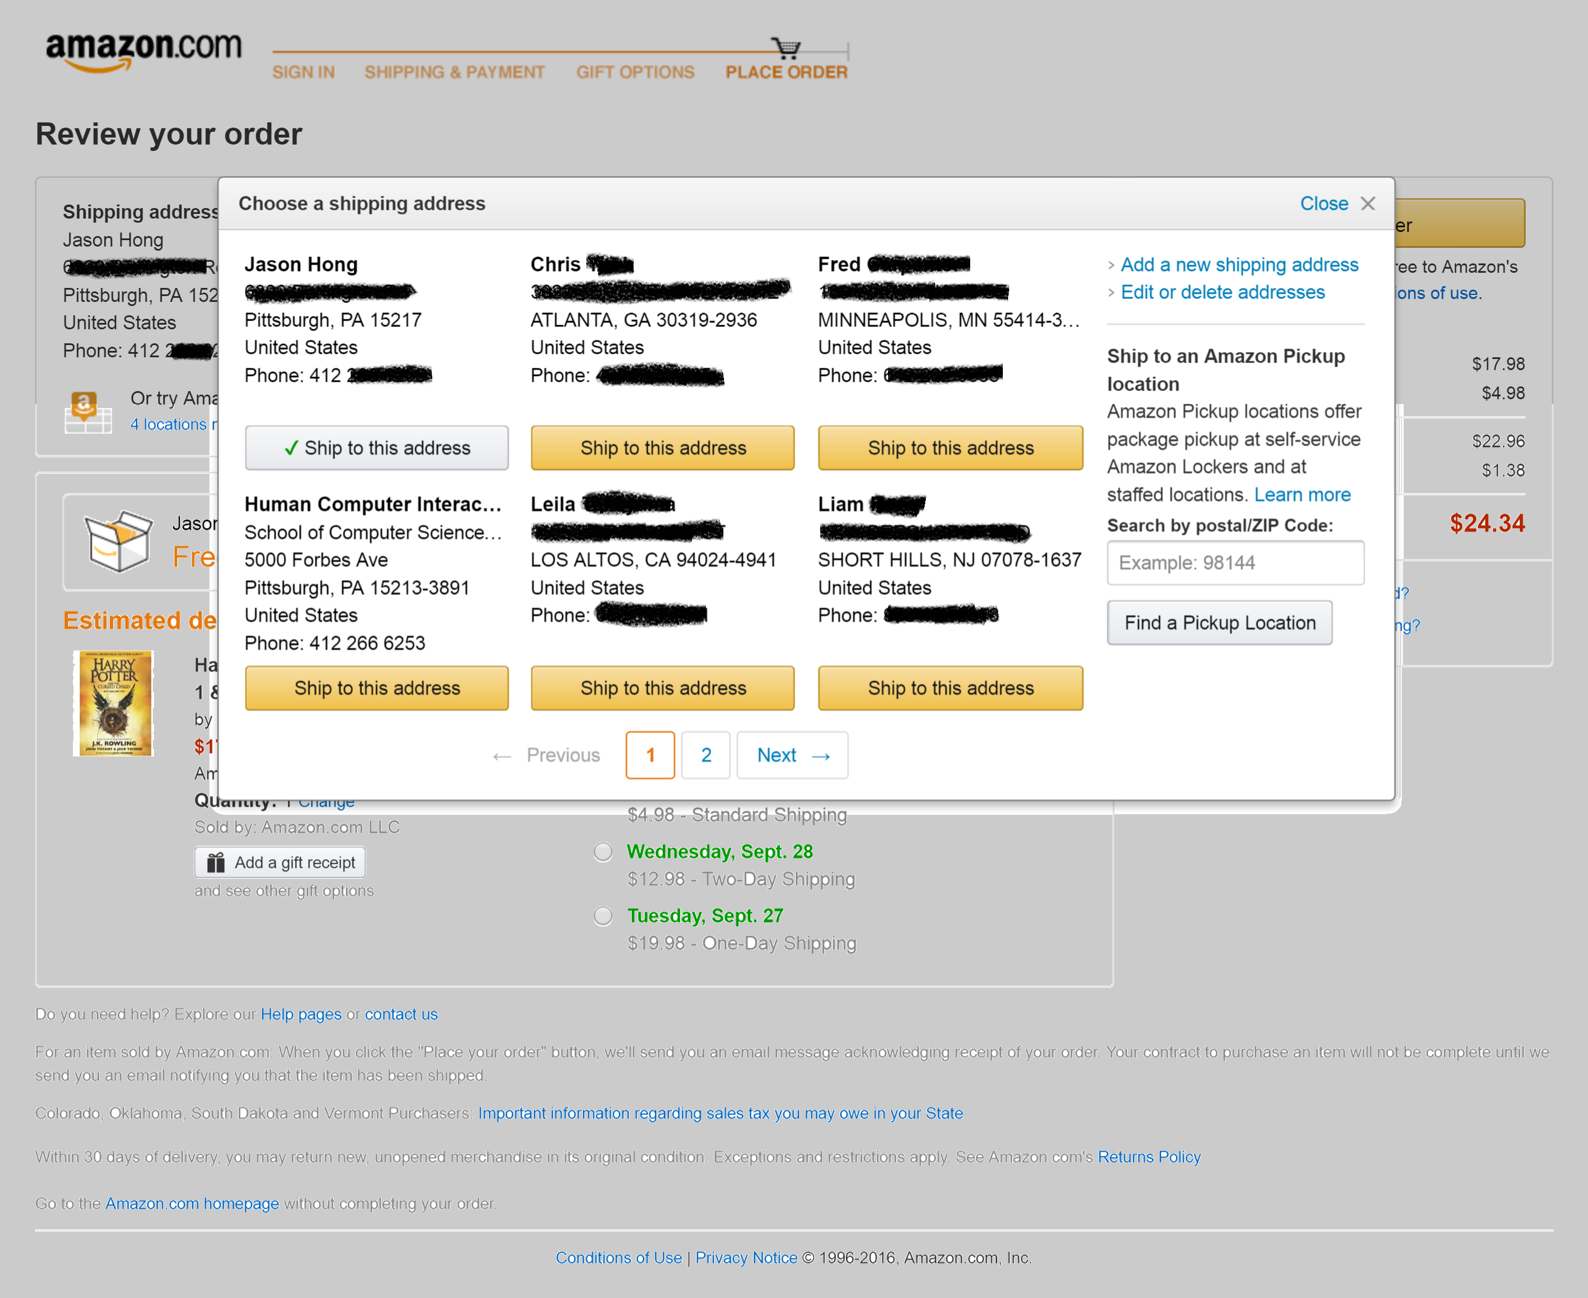

Slide 58
Process Funnel (H1)
Problem
Customers often need to complete highly specific tasks on Web sites, but pages with tangential links and many questions can prevent them from carrying out these tasks successfully.
Solution:
Minimize number of steps to complete task
Provide progress bar
Remove unnecessary links and content
Use floating windows or new tab for help

Slide 59
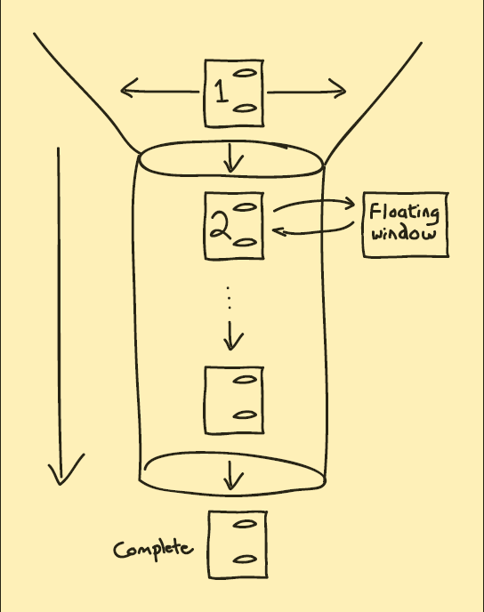
PROCESS FUNNEL (H1) Solution Diagram
Notes:
59

Slide 60
PROCESS FUNNEL (H1) Related Patterns
(A1) E-Commerce
(A10) Web Apps
(A11) Intranets
(H1) Process Funnel
(K2) Navigation Bars
(H8) Context-Sensitive Help
(K3) Tab Rows
(I2) Above the Fold
(K4) Action Buttons
(K5) High-Viz Action Buttons
(K12) Preventing Errors
(K13) Meaningful Error Messages
Notes:
60

Slide 61
Exercise: Pros and Cons of Using Design Patterns?
Chat with a partner for ~5min
(+) More efficiency / faster in your design process
(+) Patterns across sites / familiarity
(-) Hard to stand out if looks same as others
(-) Sometimes conventional solutions not good, hard to break if established
(+) Can be used across multiple touchpoints (desktop / mobile)
(-) But differences in interaction across devices / industries
Notes:
Pro
Can be good for new users if they are familiar with those design patterns
Don’t have to re-invent
Con
Something that works but necessarily good
Stifle creativity / copying everyone else
Can be confused if you do it wrong
Might be stuck in local optima / needs to be revised with new tech or tasks
(-) Potentially stifle innovation
(+) Makes web designs universal
(-) If you implement pattern incorrectly, confusing
(+) Easier to collaborate with designers and devs
Might be easier for reusable components
Potentially saves time
(-) Can repeat the same problem
Propagating bad designs
Discuss with partner for 5 minutes
(+) Easier for first-time users
(-) Design pattern might not be best solution
Ex. Qwerty keyboard
(+) Can help novice designers
(-) Harder to distinguish your own site
All look the same
(-) Can be hard to innovate after device comes out
Ex. Web sites originally designed for desktop, then iPad
(+ Common vocabulary

Slide 62
(-) Applying old patterns to emerging tech might be suboptimal
(+) Helps non-designers create better designs
(+) Starting point for creating new patterns for new platforms
(+) Can save money if saves time

Slide 63
Some Cons of Design Patterns
May lead to conventional designs
May not have good existing solutions
Time it takes to find an appropriate design pattern
Scalability issues if you have hundreds
May get stuck or be inappropriate if technology or convention changes
Ex. Before and after AJAX web sites
Ex. Before and after touchscreen (iPhone)

Slide 64
Some Pros of Design Patterns
Can help novice and expert designers
More consistent look and feel
Ex. It will feel like an Android app or an iOS app
Previously mentioned benefits:
Don’t re-invent the wheel
People already familiar with many patterns
Spend more time on other sites
Common vocabulary
Inspiration for ideas
Can help with finding usability problems
More likely to be a tested design (large companies)

Slide 65
Do Design Patterns Stifle Creativity?
My argument: Web design and smartphone app design mostly stable now
If so, then most of the innovation and value you can offer as a UX designer won’t be in radical new visuals, layouts, interactions
Instead, use design patterns so you focus on the more creative parts of design rather than parts that have already been well-solved
Exception: really new areas, like AR, autonomous, etc
Next slides show evolution of the web
Notes:
This last part of the class is to address the most common issue raised by people: do patterns limit creativity?

Slide 66
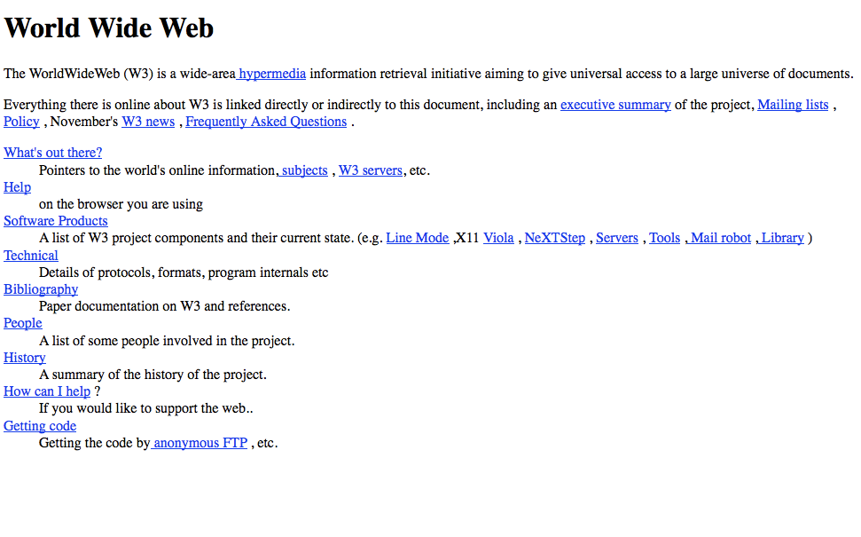
The First Web Page

Slide 67
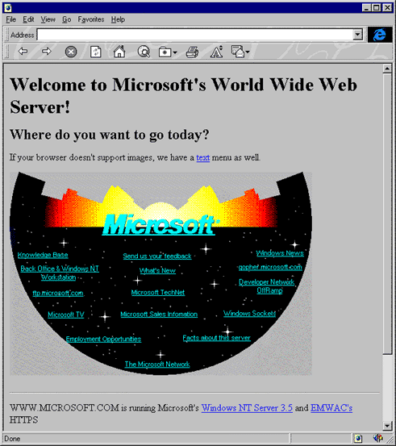
Notes:
In early days of web, no real patterns. People tried crazy designs.

Slide 68
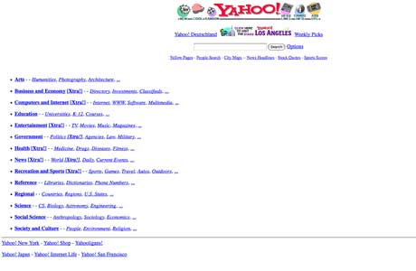
Yahoo 1994

Slide 69
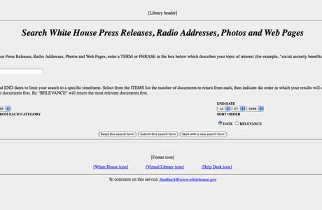
Whitehouse.gov 1994

Slide 70

MSN 1995

Slide 71
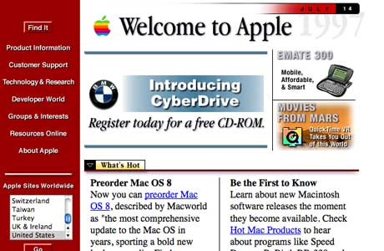
Apple 1996

Slide 72
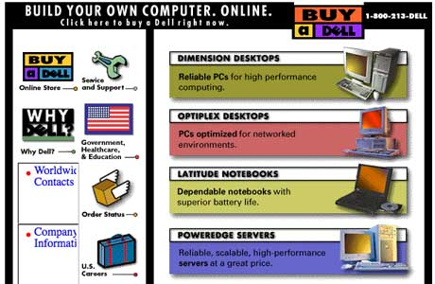
Dell 1996

Slide 73
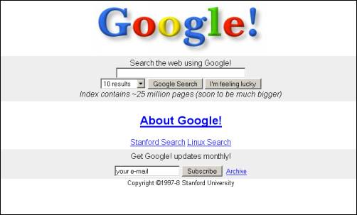
Google 1997
Notes:
Google 1997
http://www.telegraph.co.uk/technology/6125914/How-20-popular-websites-looked-when-they-launched.html

Slide 74
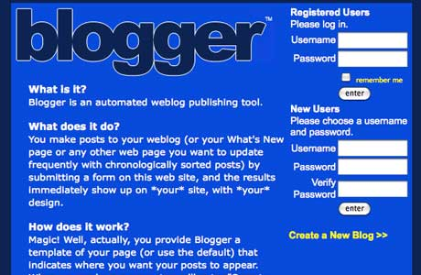
Blogger 1999

Slide 75
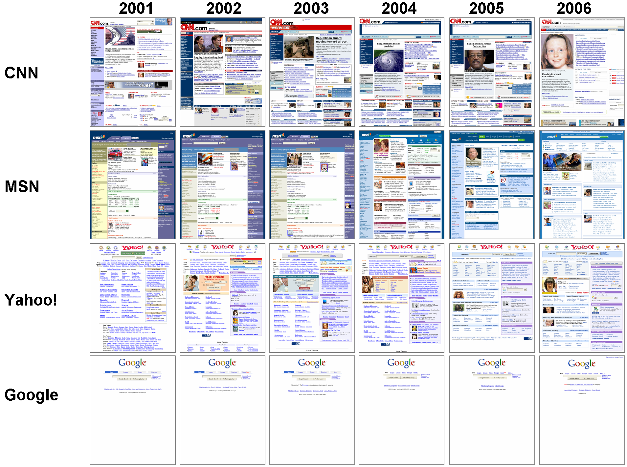
Notes:
But web site design has really started to stabilize.

Slide 76
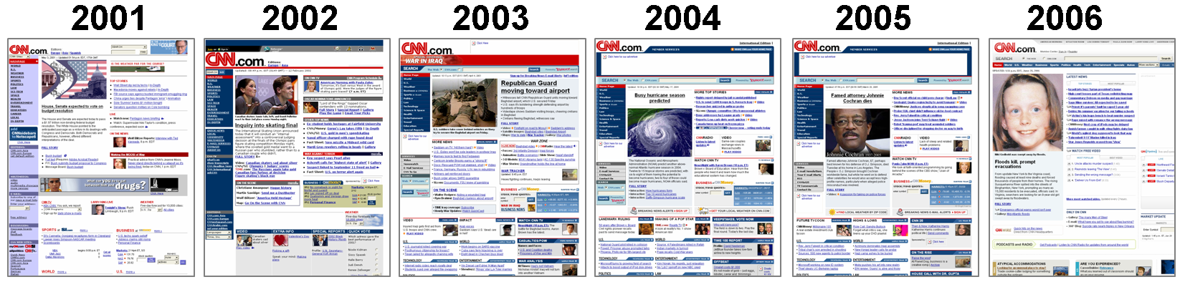

Slide 77
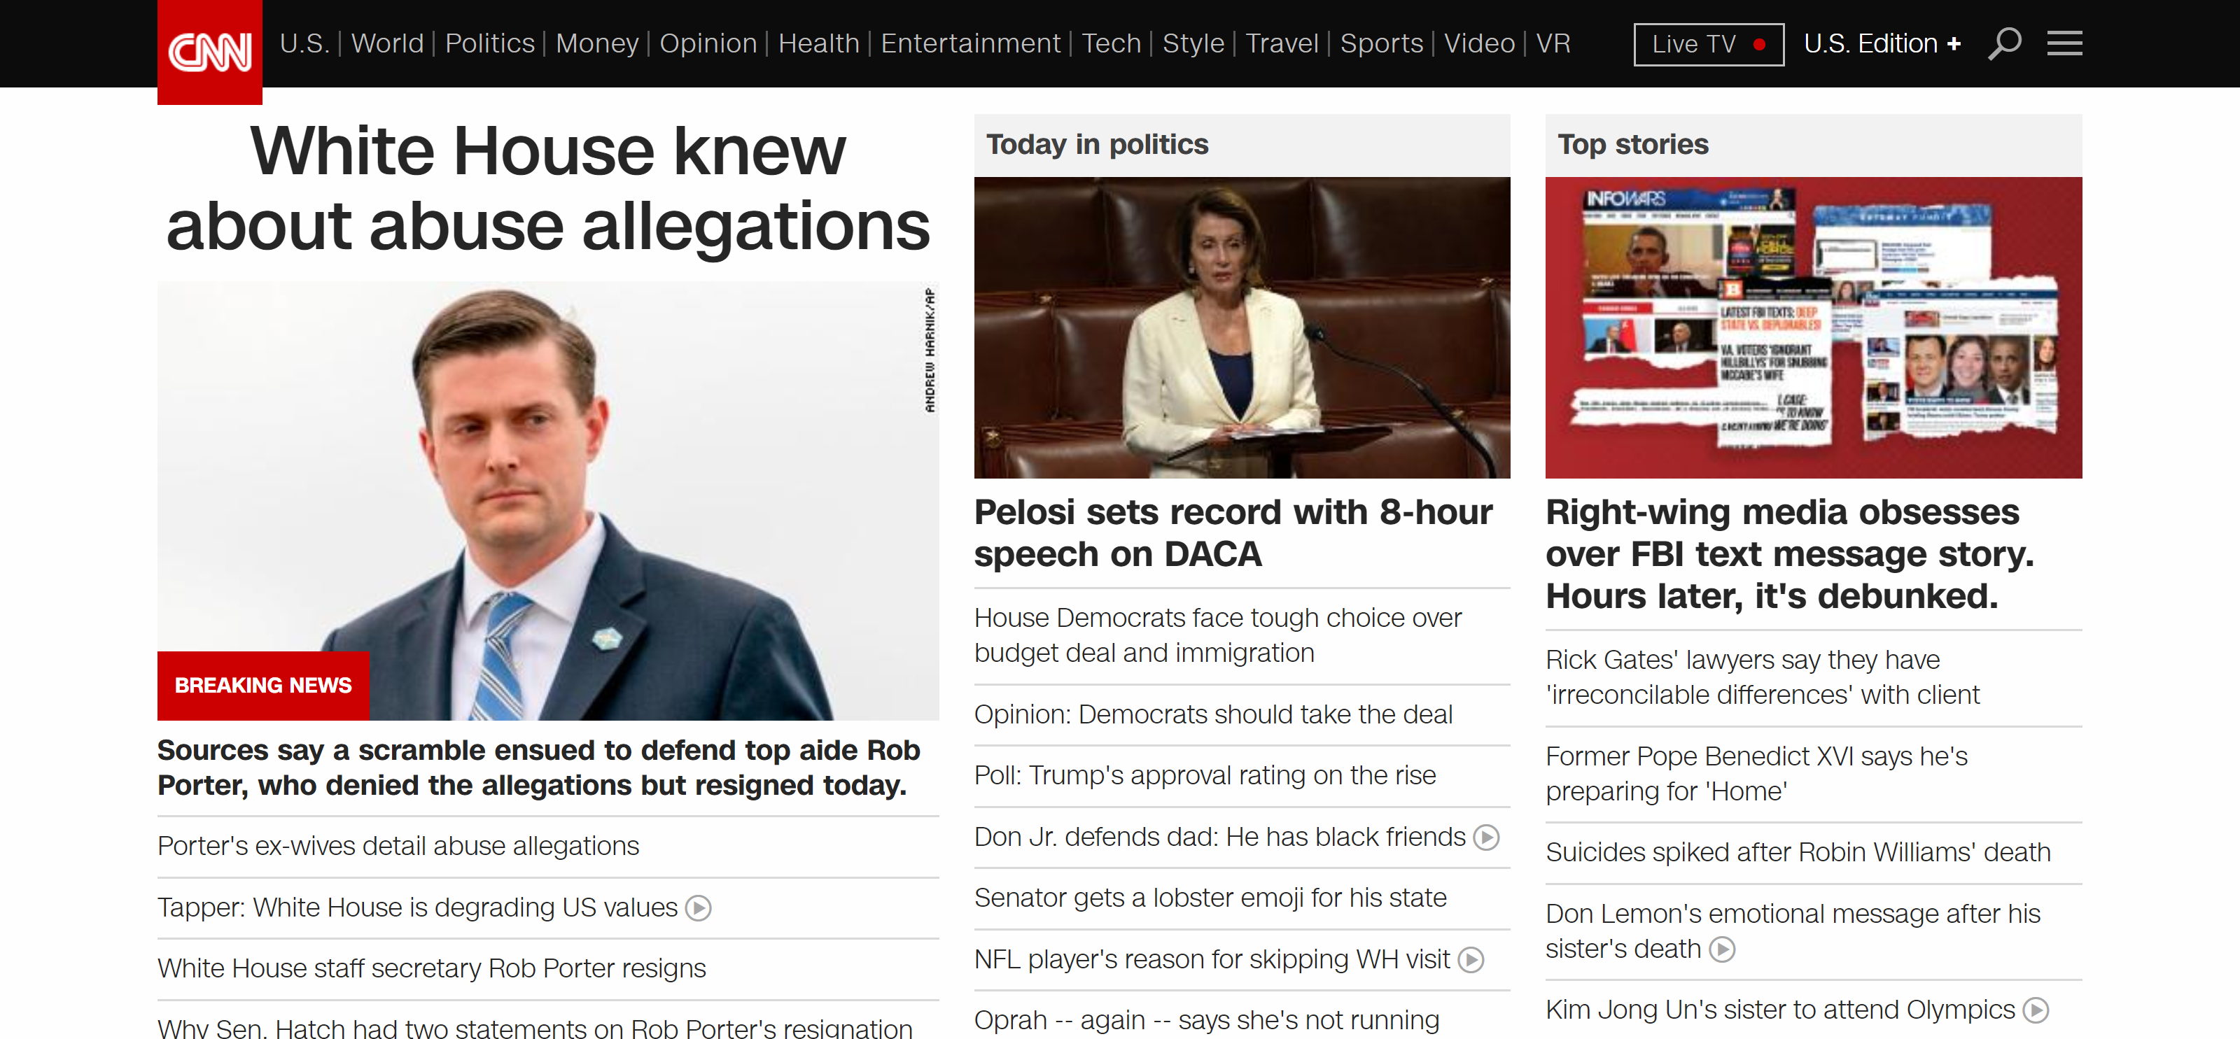
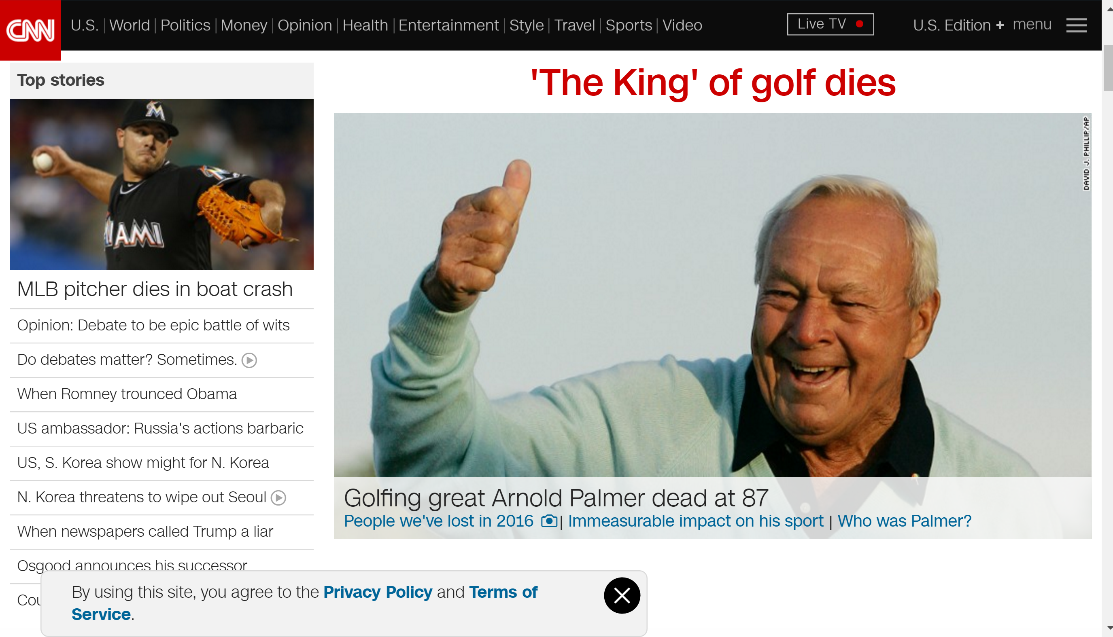
Notes:
This is CNN on Feb 7 2018
Web sites are still mostly the same. Note that CNN’s web site is now flatter, and they got rid of the side navbar, but it’s still essentially the same.

Slide 78
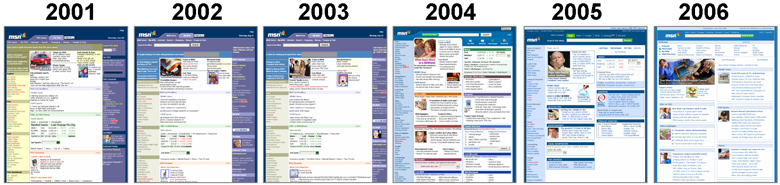
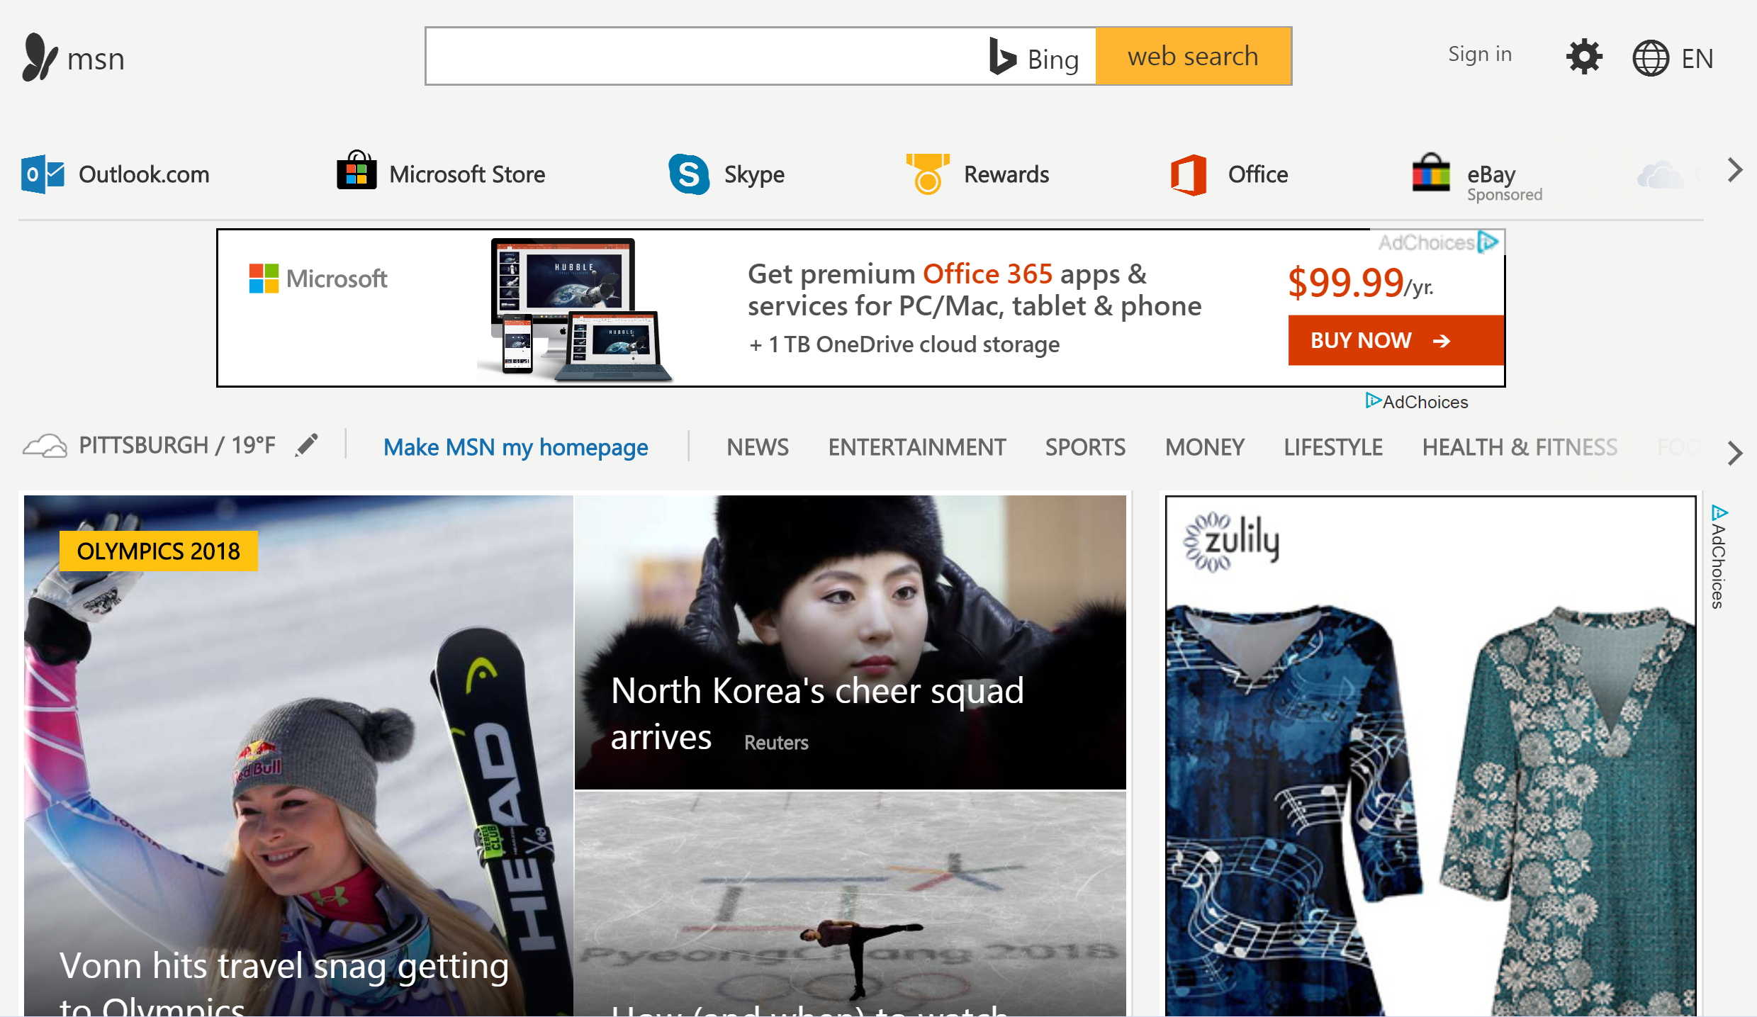
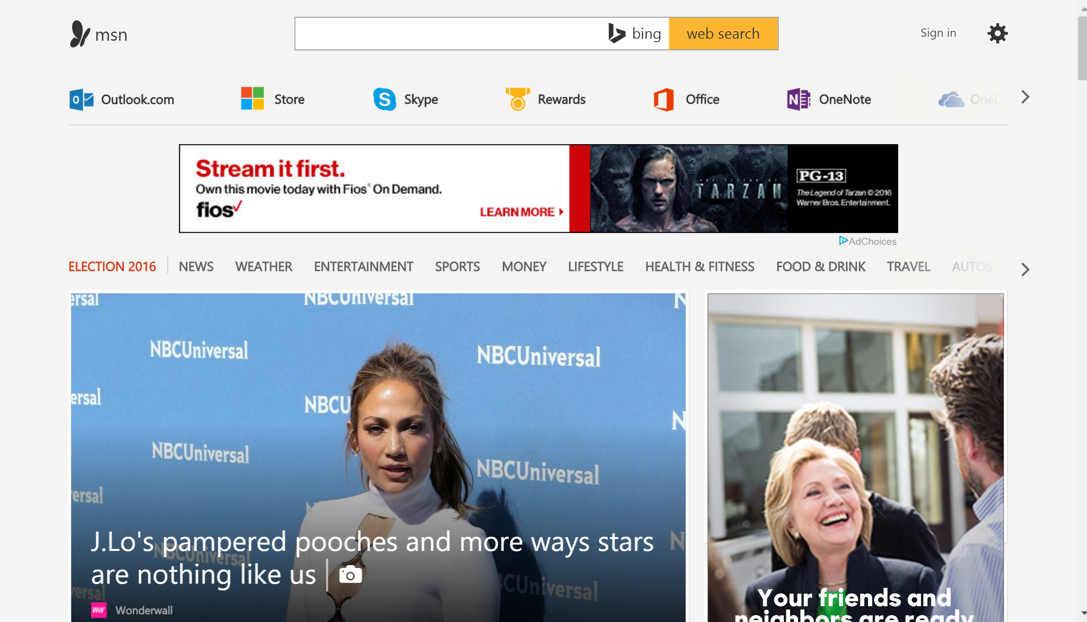
Notes:
MSN has changed a lot, but pretty similar to many other web sites. It also got flatter too.

Slide 79



Notes:
Yahoo went through a similar evolution. Got flatter, less lines, bigger images. But essence is still the same.

Slide 80


Notes:
Google hasn’t changed much.

Slide 81

tenyearsago.io

Slide 82
Another Example
I created this example 10+ years ago
Looks old, but still functional
Doesn’t match the current flat and image-heavy design common with web sites today
Notes:
And if students are still unconvinced, here is an old example. While the look and feel will feel old, the core (and the patterns) is still there.

Slide 83

1
Notes:
83
Action Buttons
High-visibility Action Buttons
Error messages
Value Proposition
Process Funnel
Product Details
Obvious Links

Slide 84

2
Notes:
84

Slide 85

3
Notes:
85

Slide 86

4
Notes:
86

Slide 87

5
Notes:
87

Slide 88

Quick-Flow Checkouts
6
Notes:
88

Slide 89

Closing Thoughts
Notes:
So to summarize design patterns…

Slide 90

Closing Thoughts
Good artists copy, great artists steal
- Picasso (apocryphal)
Notes:
It seems that Steve Jobs misattributed the quote to Picasso (it was probably TS Eliot)
Image from Wikipedia

Slide 91
Action Items
Look over these sites again
ui-patterns.com, androidpatterns.com, pttrns.com
HW3 due later today Wednesday Sep 19
HW4 (HEval) due Fri Sep 21
HW5 out later today, due Mon Oct 1
No readings for next week’s class (web)

